Slide 1
Stressed Teachers Don’t Make Good Implementers: Examining the Interplay between Work Overload and Implementation Fidelity
Madeline Larson & Aria Fiat
School Psychology Program
College of Education & Human Development
University of Minnesota, Twin Cities
Notes:
Madeline then Aria

Slide 2
Learning Objectives
Explain how work-related stress can impact EBP implementation and implementers’ willingness to utilize EBPs.
Identify stress-reduction strategies that can be utilized in consultation with providers to enhance EBP implementation.
Apply knowledge of the mechanisms of stress reduction programs to systemic problems in education that impact implementation and generalize strategies to other settings.
Introduction | Method | Results | Discussion
Notes:
Madeline

Slide 3
Prevalence of The Problem
18 million children
exhibit
social, emotional, & behavioral problems
70 – 80%
of children receive school-based services
Introduction | Method | Results | Discussion
Notes:
There are almost 84 million children living in the United states under age 18, which means that almost 25% of the children in the United States experience SEB problems at some point in their life. (Merikangas et al., 2010 )
SEB problems in childhood can lead to a wide range of long and short term problems (e.g., Archambault, Janosz, Morizot, & Pagani, 2009; Cook et al., 2010; Dube etal., 2003; Roeser, Eccles, & Strobel, 1998)
These include:
lower academic performance (Brown et al., 2005; Roeser, Eccles, & Strobel, 1998),
interpersonal difficulties (Cook et al., 2010),
school dropout and incarceration (Archambault, Janosz, Morizot, & Pagani, 2009),
drug use (Dube etal., 2003),
and unemployment in adulthood (Nielsen et al., 2011).
about 75% of students who receive services for SEB problems are seen by providers in the education sector – school counselors and school psychologists
High need for mental health support and low resource availability to deliver services
use of response to intervention frameworks, has prompted schools to reevaluate their service delivery models and methods in order to increase the efficiency with which services are provided

Slide 4
Schools as De Facto MH Setting
Introduction | Method | Results | Discussion
Notes:
Schools are primary source of mental and behavioral health service delivery for children under age 18
70 – 80% of children who receive MH support are serviced by school-based mental health professionals
schools because it offers unparalleled access to children and adolescents and serves as one of the main service settings in which universal prevention happens.
In schools, teachers represent the frontline providers of universal prevention programs. We focus on efforts to increase teachers’ classroom practices to promote students’ social, emotional, and behavioral functioning. These practices have been shown to have short-term and long-term preventative effects.
-------------------------------------------------------------------------
Most importantly:
Between 70 and 80 percent of children who received services for a mental health problem were seen by providers working within the education sector (mostly guidance counselors and school psychologists). For the majority of children who received any mental health care, the education sector was the sole source of care.
In light of the substantial amount of time children spend in educational settings (Domitrovich et al., 2010), and the fact that the majority of children receive their only SEB supports from schools

Slide 5
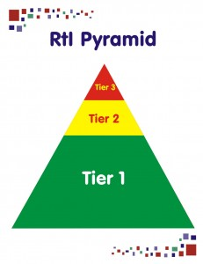
Multi-Tiered Systems of Support
MTSS Framework
Introduction | Method | Results | Discussion
Notes:
Interventions for both mental health promotion and for early detection and inclusion of children with mental disorders worldwide
Critical problems = efficient service delivery
United states solution to this problem is MTSS for behavior
Who has seen this triangle before?
How many of you use it as a guiding framework for service delivery in your practice or research?
MTSS is a data-driven method for identifying and helping struggling students in need of more intensive supports (Brown & Doolittle, 2008). Within MTSS models, staff intervene early using a multi-tiered approach where each tier provides interventions of increasing intensity.
Today we are going to focus on the delivery of Tier 1 supports, which are delivered within the classroom, by the teacher, and are typically integrated into the normal classroom routine. We are focusing on these practices because they are low-cots, high yield, have the most reach and the most potential for protecting students against experiencing SEB problems that can impeded their academic and SEB functioning
These practices are:
positive, proactive, and are provided independent of individual risk status,
Reduced potential for stigmatizing student.
They can include SEL curricula, mindfulness based practices, or classroom management strategies.
All of these practices set the stage for enhanced classroom climate, social-emotional skills learning, and the prevention of problem behaviors from occurring in the general classroom setting.
-----------------------------------------------------
In the first tier of problem solving, general education teachers are asked to provide high quality evidence-based classroom management, social-emotional learning, and behavior management strategies informed by universal screening data and frequent progress monitoring within the general education classroom. Approximately 80% of students should have their needs adequately met through Tier I supports (Berkeley, Bender, Peaster, & Saunders, 2009).
Students who are identified as “at risk” for SEB problems by universal screening are provided with Tier II intervention and supports and if they are not responsive to these, then they are provided with individualized Tier III intervention. It is estimated that approximately 15% of students will need Tier II services (Berkeley et al., 2009) and only about 5% of students require the services characterized by Tier III intervention; these students may work individually with a specialist, in small groups, or may be pulled out for support. Examples of Tier II services would include a small group intervention for students in need of social skills instruction by the school counselor and Tier III intervention may include a student participating in the school’s special education programming.
Today we will focus on Tier one and the importance of it’s implementation and health.

Slide 6
Characteristics and Importance of Tier 1
Delivered to all student regardless of need
Positive and proactive
Low cost, high yield
Enhances instructional time
Supports the facilitation of more intensive services in schools
Introduction | Method | Results | Discussion
Notes:
Today we are going to focus on the delivery of Tier 1 supports, which are delivered within the classroom, by the teacher, and are typically integrated into the normal classroom routine. We are focusing on these practices because they are low-cots, high yield, have the most reach and the most potential for protecting students against experiencing SEB problems that can impeded their academic and SEB functioning
These practices are:
positive, proactive, and are provided independent of individual risk status,
Reduced potential for stigmatizing student.
They can include SEL curricula, mindfulness based practices, or classroom management strategies.
All of these practices set the stage for enhanced classroom climate, social-emotional skills learning, and the prevention of problem behaviors from occurring in the general classroom setting.

Slide 7
Why is Implementation of Tier I Important?
Tier I supports work! (e.g., Cook et al., 2016; Domitrovich et al., 2010; Horner, Sugai, & Anderson, 2010)
Cost-benefit ratio is high for universal classroom-based practices
Good classroom management → more instruction time
Health of Tier 1 → Health of Tier II and Tier III
Introduction | Method | Results | Discussion
Notes:
Madeline
There is a wide range of evidence showing that Tier one preventative interventions work for students exhibiting a variety of problems – especially for students who exhibit behavioral problems in the classroom.
EXAMPLES OF THESE STUDIES!!!
Moreover, establishing a healthy Tier I and utilizing preventative strategies to target behavior has shown to be more cost effective in the long run and reduce problem behavior for at risk students. For example – the Good Behavior Game costs $8 per student and returns $204 per student per year.
You can reach a wider range of students through Tier one than you can service students in small group or individual service delivery settings and you increase instruction time by investing in behavior prevention strategies [INSERT THE OUNCE OF PREVENTION SOURCE HERE!!!]
In addition, the health of your Tier I supports the rest of your MTSS service delivery framework – if more than 20% of students are identified as at risk by a screener, then Tier 1 should be targeted and enhanced in order to prevent low level behavior problems from occurring and more effectively and efficiently service students with the highest level of needs and

Slide 8
Universal Prevention Programs
14,000 schools
20,000 schools
Introduction | Method | Results | Discussion
Notes:
Tier I supports work! (e.g., Cook et al., 2016; Domitrovich et al., 2010; Horner, Sugai, & Anderson, 2010)
Cost-benefit ratio is high for universal classroom-based practices
Good classroom management → more instruction time
Health of Tier 1 → Health of Tier II and Tier III
Madeline
There is a wide range of evidence showing that Tier one preventative interventions work for students exhibiting a variety of problems – especially for students who exhibit behavioral problems in the classroom.
EXAMPLES OF THESE STUDIES!!!
Moreover, establishing a healthy Tier I and utilizing preventative strategies to target behavior has shown to be more cost effective in the long run and reduce problem behavior for at risk students. For example – the Good Behavior Game costs $8 per student and returns $204 per student per year.
You can reach a wider range of students through Tier one than you can service students in small group or individual service delivery settings and you increase instruction time by investing in behavior prevention strategies [INSERT THE OUNCE OF PREVENTION SOURCE HERE!!!]

Slide 9
Foundation for Intensive Support
Introduction | Method | Results | Discussion
Notes:
I want to talk a bit about the relevance of universal programs and prctices within the broad scope of service delivery that can happen in schools.
Universal supports are the foundation upon which critical intensive services are built and it’s essential to attend to the health of your Tier 1 implementation to ensure that your school has the capacity and readiness to deliver high quality, intensive supports to those students who are unresponsive to services in the general classroom setting. This is resource efficiency but it is also key for better services for kids with significant needs to free up room for delivery of supports that better match their needs.
Interventions for both mental health promotion and for early detection and inclusion of children with mental disorders worldwide
Critical problems = efficient service delivery
United states solution to this problem is MTSS for behavior
Who has seen this triangle before?
How many of you use it as a guiding framework for service delivery in your practice or research?
MTSS is a data-driven method for identifying and helping struggling students in need of more intensive supports (Brown & Doolittle, 2008). Within MTSS models, staff intervene early using a multi-tiered approach where each tier provides interventions of increasing intensity.
Today we are going to focus on the delivery of Tier 1 supports, which are delivered within the classroom, by the teacher, and are typically integrated into the normal classroom routine. We are focusing on these practices because they are low-cots, high yield, have the most reach and the most potential for protecting students against experiencing SEB problems that can impeded their academic and SEB functioning
These practices are:
positive, proactive, and are provided independent of individual risk status,
Reduced potential for stigmatizing student.
They can include SEL curricula, mindfulness based practices, or classroom management strategies.
All of these practices set the stage for enhanced classroom climate, social-emotional skills learning, and the prevention of problem behaviors from occurring in the general classroom setting.
-----------------------------------------------------
In the first tier of problem solving, general education teachers are asked to provide high quality evidence-based classroom management, social-emotional learning, and behavior management strategies informed by universal screening data and frequent progress monitoring within the general education classroom. Approximately 80% of students should have their needs adequately met through Tier I supports (Berkeley, Bender, Peaster, & Saunders, 2009).
Students who are identified as “at risk” for SEB problems by universal screening are provided with Tier II intervention and supports and if they are not responsive to these, then they are provided with individualized Tier III intervention. It is estimated that approximately 15% of students will need Tier II services (Berkeley et al., 2009) and only about 5% of students require the services characterized by Tier III intervention; these students may work individually with a specialist, in small groups, or may be pulled out for support. Examples of Tier II services would include a small group intervention for students in need of social skills instruction by the school counselor and Tier III intervention may include a student participating in the school’s special education programming.
Today we will focus on Tier one and the importance of it’s implementation and health.

Slide 10
Provider Implementation
25-55%

Slide 11
What “Works” and What Actually Happens
Service Delivery Framework
Implementation Barriers
Buy-In
Training
Support
Etc., Etc., Etc…
Introduction | Method | Results | Discussion
Notes:
While there are a lot of great programs and supports out there to enhance student SEB development, we know that a lot of these practices and programs do not get utilized in every day settings. Teachers find many barriers to practice that impeded their ability to implement the programs with fidelity and this impacts the yield that we see in student behavior change.
Overall, there is a wide gap between what is developed through research and what is actually implemented in practice – This is often called the implementation gap.
Many of the supports that are studied in research and stamped as evidence-based practices are not actually utilized in school settings, especially if they are supports that are implemented by the teacher on the universal, classroom level
Unfortunately, if evidence based practices aren’t being used and aren’t successfully implemented at the universal level, then students will not receive the benefits of these programs- so we need to focus on what we can do to support the successful implementation of these programs in classroom settings.
Results of this study imply that the implementation quality of school prevention programs is generally poor (Gottfredson & Gottfredson, 2002). Depending on the type of activity, only one-fourth to one-half of the programs compared favorably with research-based programs of the same type in terms of the number of sessions offered. In addition, again depending on type, only 47–78% of programs lasted for longer than 1 month.
-Implementation science focuses on the factors and conditions that facilitate or impede the adoption and use of EBPs to improve service recipient outcomes (Eccles & Mittman, 2006) and this is what we are going to focus much of our talk on today.

Slide 12
Acquisition vs. Performance
Introduction | Method | Results | Discussion
Notes:
Albert Bandura’s acquisition and performance deficit model help which argues that all individuals will struggle to implement under one of two situations. (1) they have not learned/acquired the necessary skills and behaviors (can’t do) OR they are improperly motivated to do so (won’t do).
Clay talked a little bit yesterday about pre-implementation supports to “prime the pump for implementation – and today we are going to discuss a critical root cause that can effect the qualityof service delivery during ACTIVE implementation

Slide 13
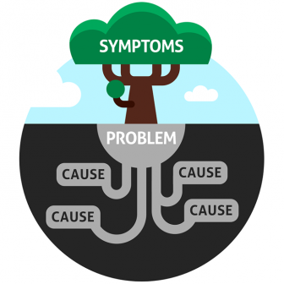
Root Cause Analysis
Introduction | Method | Results | Discussion
Notes:
So, we have an implementation problem that needs a solution.
To solve problems there is a need to conduct a root cause analysis that captures malleable factors that explain why a provider fails to successfully implement under optimal
conditions—that is leadership support and high quality training and consultation.

Slide 14
Discussion
How many of your schools are currently implementing some kind of universal EBP?
Who implements these practices in the classroom?
Have you observed any barriers to getting teachers to use universal EBPs?
What are the barrier you see in practice of in research?
Introduction | Method | Results | Discussion
Notes:
Madeline
First discuss in pairs and then share out to the group
This is the implementation or research-to-practice “gap”

Slide 15
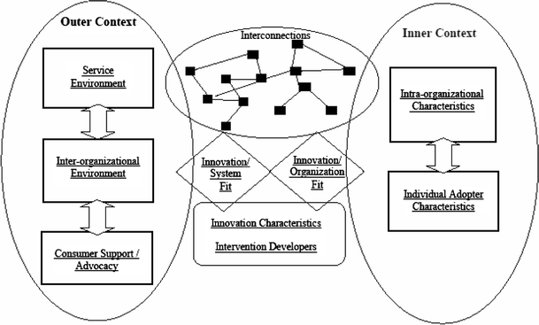
Implementation Science
Figure from Aarons, Hurlburt, & Horwitz, 2011
Introduction | Method | Results | Discussion
Notes:
Madeline
-Implementation science focuses on the factors and conditions that facilitate or impede the adoption and use of EBPs to improve service recipient outcomes (Eccles & Mittman, 2006).
And this is
Outer context:
funding from state to support early intervening services / money
Inter-organizational networks – could include university partnerships
Inner context;
Organizational factors – readiness to change; pre-existing knowledge and skills; culture and climate
Individual adopter characteristics – attitudes toward and perceptions of change; social network; perceived need for change
These factors interact and impact each other but research shows that :
Regardless of the implementation context (optimal or less than optimal), the utilization and sustainability of EBPs relies heavily upon individual behavior change
For many EBP the teacher is the primary implementer (Forman et al., 2009);
understanding individual-level factors that facilitate or impede teacher delivery of EBPs is especially important to improve student outcomes (Cook et al., 2015).
Implementation boils down to the individual and teachers are most likely implementers
---------------------------------------------
Because of this wide research-to-practice gap, research is increasingly moving away from developing new practices and programs, and instead focusing on understanding the implementation processes, outcomes, and strategies that help transfer research findings into real-world settings (Dane & Schneider, 1998) and established the cross-disciplinary field of implementation science.
Implementation science is the scientific inquiry of the factors and conditions that facilitate or impede the adoption and use of EBPs to improve service recipient outcomes (Eccles & Mittman, 2006).
Research focusing on implementation science suggests that a variety of individual-level and contextual factors influence EBP uptake and use
Leadership
Climate
Quality of professional development
Regardless of the implementation context (optimal or less than optimal), the utilization and sustainability of EBPs relies heavily upon individual behavior change
For many EBPs, especially those focused on academic outcomes or universal practices targeting students’ SEB outcomes, the teacher is the primary implementer (Forman et al., 2009); therefore, understanding individual-level factors that facilitate or impede teacher delivery of EBPs is especially important to improve student outcomes (Cook et al., 2015).
Implementation boils down to the individual and teachers are most likely implementers

Slide 16
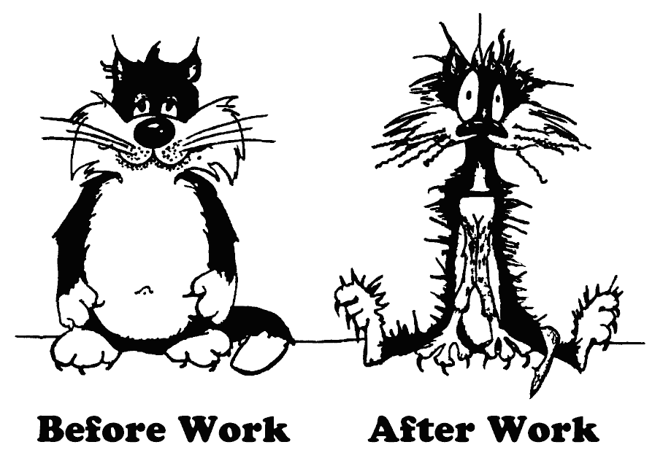
Opening Pandora’s Box
Let’s talk about stress…!
Introduction | Method | Results | Discussion
Notes:
Aria

Slide 17
Stress = Malleable Root Cause
Stress impedes implementation
Reduce stress via positive psychological practices
Enhance implementation
Better clinical outcomes
Introduction | Method | Results | Discussion
Notes:
Aria
Research indicates that stress may represent a malleable root cause that impacts particular teacher’s openness and willingness to implement something new
Additionally, a growing body of research has identified positive psychological practices – ranging from mindfulness to gratitude to acts of kindness – that can improve wellbeing if practiced regularly (Seligman, 2002; Sin &amp; Lyubomirsky, 2009).
Teacher intentions to implement could be enhanced by a wellbeing-promoting intervention prior to the implementation of classroom-based EBPs, suggesting that teachers’ social-emotional wellbeing may be an important factor associated with teachers’ implementation intentions and actual behaviors related to the delivery of EBPs in their classroom environment.
Unfortunately, many initiatives and policies that set high standards for teacher implementation of EBPs show little concern for teachers’ social-emotional wellbeing or address how it impacts their willingness and ability to deliver EBPs (Cook et al., 2016).

Slide 18
Stress and Teaching
Lack of training
Increasing demands
Lack of coping strategies
Stress and burnout
Deteriorating climates
(Jennings & Greenberg, 2008)
Introduction | Method | Results | Discussion
Notes:
Aria
Teaching is inherently stressful
Many teachers don’t have prior knowledge in classroom management – but there is a high need for this in schools
Many teachers become stressed because of increasing demands and diverse tasks
INSERT STATISTC/PREVELANCE HERE
This can lead to poor instruction, deteriorating relationships and classroom climate
----------------------------------------------------------------------------
Teaching is one of the most stressful jobs as indicated by a variety of nationwide surveys and research shows that teachers’ overall wellbeing and SEB competency may impact their classroom environment and practices
Teachers are tasked with delivering instructional content needed for academic growth and many are under intense pressure to adopt a range of evidence-based practices and manage substantially diverse classrooms of students (Gu & Day, 2013; Miller, Brownell, & Smith, 1999; Jackson, Schwab, & Schuler, 1986; Leiter & Maslach, 2004).
Unfortunately, majority of teachers in the United States did not receive any formal training on classroom management and received little to no coursework related to evidence-based practices during their own schooling and certification (Christofferson & Sullivan, 2015; Scott & Nelson, 1999).
In addition, teachers who are the least prepared to handle significant behavioral difficulties in the classroom most often teach students with the highest behavioral and mental health needs (D. Arnold, McWilliams, E. Arnold, 1998; Ingersoll, 2001).
As teachers enter classrooms without the necessary training to effectively manage classrooms and engage students in learning, teachers often rely on reactive and excessively punitive responses to student problem behavior, which creates to a continual cycle of classroom disruption (Jennings & Greenberg, 2009).
This type of deteriorating classroom environment not only has significant implications for students’ overall academic achievement and social development, but also exposes teachers to chronic stress, which saps teachers’ self-efficacy, motivation to try new things, and overall social-emotional wellbeing (Jennings & Greenberg, 2009).
On top of all of this Chronic stress can lead to burnout which is characterized by emotional exhaustion, when teachers feel they have nothing left to give psychologically and emotionally; depersonalization, when teachers begin to develop negative or cynical attitudes and feelings toward students; and lack of personal accomplishment, when teachers begin to minimize and devalue achievements on the job.
Decades of research have attributed this phenomenon to social, economic and political factors – ranging from increasingly difficult student behavior to insufficient resources and administrative burden. Unfortunately, burnout has untoward effects on teachers, classrooms, schools and districts, ultimately compromising the quality of care and instruction students receive .

Slide 19
Work Overload and Implementation Behavior
Increased efforts lead to work overload
New practices increase burden
Could potentially lower implementation quality and dosage
Introduction | Method | Results | Discussion
Notes:
Aria
Because of the increasing tasks and increased implementation efforts happening in schools teachers may experience a specific type of stress related to work overload which may significantly impact their ability and motivation to implement universal, Tier 1 supports in their classrooms.
Work overload is characterized as:
Perceiving everyday tasks as so demanding that coping is only possible with substantial effort.
Individuals feel their time, abilities or resources are insufficient to meet the demands placed on them.
When individuals perceive that they cannot cope with the demands of a task or engage in healthy habits to mitigate stress, they become overwhelmed (Michie & Williams, 2003). As such, stress related to work overload has been linked to workforce issues such as negative attitudes toward organizational change (Vakola, Tsaousis, & Nikolaou, 2003),
as well as systemic issues such as turnover (Ahuja, Chuboda, Kacmar, McKnight, & George, 2007), absenteeism (Rauhala et al., 2007), and work-to-family conflict (Bolino & Turnley, 2005).
This phenomenon may be exacerbated in schools operating in economically disadvantaged contexts.
. This phenomenon may be exacerbated in schools operating in economically disadvantaged contexts. As indicated by a large body of research, schools operating in economically disadvantaged settings are often undertaking increased implementation efforts to address opportunity and achievement gaps with fewer organizational resources (DuFour, DuFour, Eaker, & Karhanek, 2010).
schools operating in economically disadvantaged settings are often undertaking increased implementation efforts to address opportunity and achievement gaps with fewer organizational resources (DuFour, DuFour, Eaker, & Karhanek, 2010)
these settings often retain teachers who have little experience utilizing EBPs, as teachers with more effective management skills often move to higher paying positions in less challenging contexts (Jacob, Vidyarthi, & Carroll, 2012).
teachers working in economically disadvantaged contexts tend to serve historically marginalized groups of students who may require more intensive academic and SEB supports (Day & Hong, 2016). The responsibility of responding to these unique needs often rests on teachers, which may especially compound stress resulting from work overload in high need settings specifically.
When reviewing this literature in the context of the broader body of research on teacher stress, it becomes clear that one potential hypothesized causal factor undermining teachers’ successful EBP implementation is stress due to work overload
Stress not only has an impact on the classroom, but on implementation – stress is an individual level factor within the inner context of implementation that may impact the uptake and use of Tier I interventions such as universal classroom management strategies.
Although few studies have examined how psychological constructs relate to implementation of academic or preventive interventions (Evers et al, 2002), psychological functioning probably has an impact on implementation quality, particularly when program innovations are perceived as causing additional burden or competing with other priorities.
if a new program is adopted without a consideration for them individually, teachers may experience burden and stress, which can negatively affect program implementation. pre-implementation trainings that incorporate principles of mindfulness to reduce stress and promote emotional insight.
------------------------------------------
As such, teachers may experience a specific type of stress related to work overload which may significantly impact their ability and motivation to implement universal, Tier 1 supports in their classrooms.
Work overload is characterized as:
Perceiving everyday tasks as so demanding that copying is only possible with substantial effort.
Individuals feel their time, abilities or resources are insufficient to meet the demands placed on them.
When individuals perceive that they cannot cope with the demands of a task or engage in healthy habits to mitigate stress, they become overwhelmed (Michie & Williams, 2003). As such, stress related to work overload has been linked to workforce issues such as negative attitudes toward organizational change (Vakola, Tsaousis, & Nikolaou, 2003),
as well as systemic issues such as turnover (Ahuja, Chuboda, Kacmar, McKnight, & George, 2007), absenteeism (Rauhala et al., 2007), and work-to-family conflict (Bolino & Turnley, 2005).
This phenomenon may be exacerbated in schools operating in economically disadvantaged contexts.
. This phenomenon may be exacerbated in schools operating in economically disadvantaged contexts. As indicated by a large body of research, schools operating in economically disadvantaged settings are often undertaking increased implementation efforts to address opportunity and achievement gaps with fewer organizational resources (DuFour, DuFour, Eaker, & Karhanek, 2010).
schools operating in economically disadvantaged settings are often undertaking increased implementation efforts to address opportunity and achievement gaps with fewer organizational resources (DuFour, DuFour, Eaker, & Karhanek, 2010)
these settings often retain teachers who have little experience utilizing EBPs, as teachers with more effective management skills often move to higher paying positions in less challenging contexts (Jacob, Vidyarthi, & Carroll, 2012).
teachers working in economically disadvantaged contexts tend to serve historically marginalized groups of students who may require more intensive academic and SEB supports (Day & Hong, 2016). The responsibility of responding to these unique needs often rests on teachers, which may especially compound stress resulting from work overload in high need settings specifically.
When reviewing this literature in the context of the broader body of research on teacher stress, it becomes clear that one potential hypothesized causal factor undermining teachers’ successful EBP implementation is stress due to work overload

Slide 20
Simmer down now… Let’s try to reduce the problem and close the box.
Introduction | Method | Results | Discussion

Slide 21
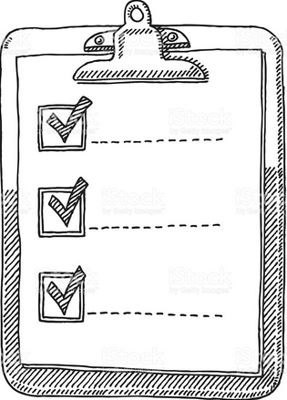
Purpose of Study
To examine experimentally the impact of teacher stress reduction via wellness coaching on the delivery of EBPs.
Introduction | Method | Results | Discussion
Notes:
Madeline

Slide 22
Research Questions
Do teachers’ distress ratings systematically decrease as a result of providing wellness coaching?
Do reductions in teacher stress co-occur with improvements in the fidelity of implementation of classroom-based EBPs?
Introduction | Method | Results | Discussion
Notes:
Madeline

Slide 23
Study Context
Partner with school administration
Identify and define implementation concerns
Develop an intervention approach
Decide on contextually appropriate research methods
Low Cost, High Yield EBPs
Positive Greetings at the Door
Behavior Specific Praise
Numerous Opportunities to Respond
Introduction | Method | Results | Discussion
Notes:
Madeline
This study occurred in the context of a larger collaboration effort with investigators and school administration
School recruitment & collaboration
At the time of the study, the school was actively participating in a district-wide effort to implement a multi-tiered system of supports targeting students’ social, emotional, and behavioral outcomes,
School—wide positive behavior interventions and supports (SW-PBIS)
Social-emotional learning (SEL) curriculum (Second Step).
For the purposes of this study, the school was actively undertaking the dissemination and implementation of proactive classroom management strategies that were identified as non-negotiables to implement by every teacher in the school
STRATEGIES (Low-cost, high-yield EBPs - Proactive classroom management strategies):
positive greetings to students at the door
is designed to engage students in a relationship with the teacher when the student transitions into the classroom, as well as provide pre-corrective statements to prevent behavior problems
behavior specific praise
predicated on the extensive empirical support for behavior-specific praise (Briere, Simonsen, Sugai, & Meyers, 2015)
providing numerous opportunities to respond
among the most widely researched proactive strategies
It involves engaging students academically by integrating regular active student response to questions or statements

Slide 24
Participants & Setting
Economically disadvantaged urban community
K-5 elementary school teachers (n=37)
Teachers with poor implementation fidelity (n=11)
Teachers endorsing high stress (n=6)
n = 4
Consent
Introduction | Method | Results | Discussion
Notes:
Madeline
Urban K-5 elementary school operating in an economically disadvantaged area
Student demographics:
456 students
Racially diverse (Hispanic/Latino = 65%, White = 15%, Black = 9%, Other = 11%)
78% of the students receiving free and reduced lunch
14% receiving special education services
48% English Language Learners
Teacher characteristics: 37 fully credentialed teachers; average of 12.8 years teaching experience.
Multiple gating:
Teachers (in the entire school) trained to deliver classroom management strategies (3); instructional coach provided follow-up support
Those who had poor implementation despite training and support (less than 50% fidelity) (N=11) → measured stress → those who endorsed high levels (6 or greater on SUDS) were invited to participate (N=6)
Recruited to participate in a pilot study focusing on improving teachers’ self-care via a school-based wellbeing program
4/6 consented
Participating Teachers:
all were female (100%)
majority were Caucasian (75%)
range of teaching experience -- 2 to 26 years (M = 11.75, SD = 10.78)

Slide 25
Research Design & Measures
Multiple-baseline single case design across participants and behaviors.
Dependent Variable
Measure
Implementation of proactive classroom management strategies
Intervention Fidelity Rubric
Independent Variable:
ACHIEVER Resilience Curriculum (ARC)
Subjective Work Stress
Subjective Units of Distress Scale (SUDS)
Wolpe (1969); Sanetti & Kratochwill, 2009
Introduction | Method | Results | Discussion
Notes:
Madeline
Strong psychometrics for SUDS
11-point scale ranging from 0 = Feeling peaceful and completely relaxed at work to 10 = Feeling unbearably stressed out and overwhelmed
Fidelity rubric – self-report
Measured adherence
Distilled the active ingredients for rubric (Sanetti)
Intervention Fidelity Rubric
Self-report form to capture adherence (accuracy) to implementing each of the ingredients
Collected daily
Developed using guidelines by Sanetti & Kratochwill, 2009
Operational definitions were created for each classroom management practice
Scores were aggregated to create individual-level estimates of delivery (across all three practices)
Also were used to provide performance-based feedback to teachers
SUDS
Extensively used in clinical and behavioral treatment
Monitor impact of therapeutic interventions
11-point scale
0 = Feeling peaceful and completely relaxed at work
10 = Feeling unbearably stressed out and overwhelmed

Slide 26
EBP Delivery & Training
An important feature of the study was the training and follow-up supports that teachers received to implement the EBP’s.
Three after school PD sessions
Implementation scripts
Follow-up support
Instructional coach
Introduction | Method | Results | Discussion
Notes:
Madeline
As part of the participator action research, all teachers in the school received training to implement the three proactive classroom management strategies
TRAINING
3 after school PD’s (1.5 hrs per session)
Tell-show-do format
Socractic questions
Small group discussion to maintain engagement
Implementation scripts (to deliver EBPs with fidelity)
Follow-up support
Grade-level professional learning community meetings
Every two-weeks
Topics: reflection & problem solving to increase implementation
Instructional Coach
Ongoing consultative support to teachers (to improve implementation)

Slide 27
ACHIEVER Resilience Curriculum
A wellbeing-promoting intervention designed to train teachers in specific wellbeing-promoting skills, habits, and routines.
Grounded in
Positive psychology
Cognitive-behavioral therapy
Acceptance commitment therapy
Introduction | Method | Results | Discussion
Notes:
Aria
ACHIEVER Resilience Curriculum (ARC)
a wellbeing-promoting intervention designed to train teachers in specific wellbeing-promoting skills, habits, and routines (hereafter referred to as resilience practices) that enable them to become resilient
Underlying assumption: teachers with higher wellbeing/resilience will better be able to optimize relationships, create a pos. classroom climate, and implement EBPs
Grounded in:
Pos. psychology
CBT
ACT
School counselors were trained to deliver a menu of resilience practices, and to work with teachers to develop individualized wellbeing plans based on teacher-specified need

Slide 28
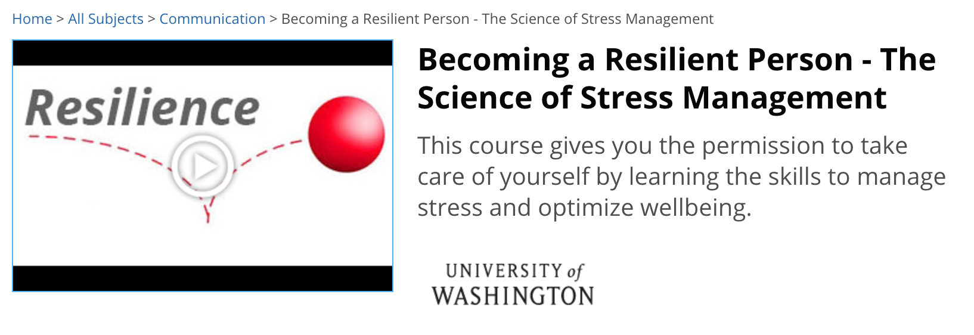
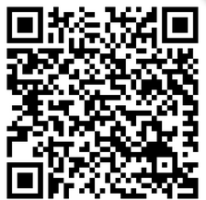
Introduction | Method | Results | Discussion

Slide 29
ACHIEVER Components
Awareness and empowerment through mindfulness-based practices
Choosing to pay attention to the positive and practicing gratitude
Helping and doing good deeds for others
Identifying unhelpful thoughts and altering them to be more helpful
Engage in good sleep, exercise regularly, and eat well
Values clarification and commitment
Establishing good social support, role model(s), and a mentor (relationships)
Rewarding yourself through relaxation and recreation
Introduction | Method | Results | Discussion
Notes:
Flexible, consultative/coaching support format – tailored to providers’ individual and self-assessed needs.
Describe components
Session Overview:
Select intensity of coaching support
Decided frequency will very – but must meet at least once per week
Decided length of session can vary (e.g., 10 min., 1 hr.)
Select coaching session content
Select content from menu of ACHIEVER component options
ACHIEVER components include:
Decided length of session can vary (e.g., 10 min., 1 hr.)
Awareness and empowerment through mindfulness-based practices
Choosing to pay attention to the positive and practicing gratitude
Helping and doing good deeds for others
Identifying unhelpful thoughts and altering them to be more helpful
Engage in good sleep, exercise regularly, and eat well
Values clarification and commitment
Establishing good social support, role model(s), and a mentor (relationships)
Rewarding yourself through relaxation and recreation

Slide 30
Session Format
Know: Knowledge-building and understanding selected resilience skill, habit, or routine.
See: Modeling or showing a video demonstration of particular skills, habits, and routines in action.
Do: End with developing Personalized Action Plan.
Get participants to try and apply skill outside of session
Introduction | Method | Results | Discussion
Notes:
Session Content:
The first set of coaching sessions should cover the two “meta-practices” that provide the foundation for other resiliency/wellness skills: (1) Values clarification and commitment and (2) Mindfulness based practices (e.g., Mindful STOP, mindful breathing, mindful commute, and mindful breaks with students). The remaining sessions should be based on individualized wellness needs chosen from ARC components and may very in number depending upon each teacher’s specific needs and progress.
Additionally, the content of sessions will very across teachers based on the tailoring components outlined in each teacher’s individualized plan. However, all coaching sessions are organized according to the Know, See, Do, and Improve method, which is modeled after a direct instruction approach (Joyce, Weil, & Calhoun, 2004), developed by the National Center of Quality Teaching and Learning for delivering high-quality professional development. Each section of the method is outlined below:

Slide 31
Results: Teacher 1
Looking for:
Trend
Level
Variability
Is there a functional relationship?
ARC Begins
SUDS Ratings Implementation Fidelity
Introduction | Method | Results | Discussion
Notes:
Aria
Used SCD to look at changes in stress and fidelity. The cool thing about this methodology it lends itself really well to practice – this can be used by practitioners in a variety of settings and there are really quick and dirty measures that still have strong psychometric properties that are feasible to use.
Data-based decision-making
Flexible across settings
Feasible for practice
Orient to graphs
Y-axes are SUDS and implementation fidelity
X-axis represents weeks
Orient to MBD
Trend
Level Variability
Examine functional relationship for teacher 1

Slide 32
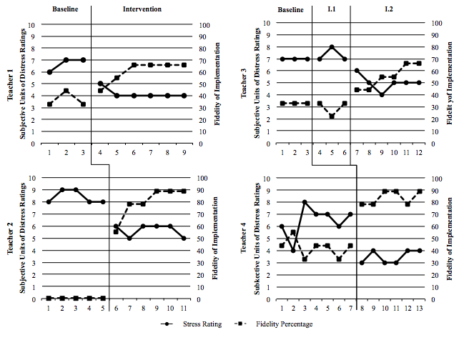
Introduction | Method | Results | Discussion
Introduction | Method | Results | Discussion
Notes:
Aria
Stress: All 4 teachers endorsed high levels of subjective stress (between 6 & 9 on the SUDS) at baseline
A decrease in level was observed for all 4 teachers after the ARC
Implementation: All 4 teachers had less than 50% implementation fidelity at baseline (with teacher 2 at 0%)
An increase in level was observed for all 4 teachers after the ARC
Interaction
What do you observe that’s interesting about the graphs?
What are the main takeaways

Slide 33
Results
Across all four teachers
Reductions in subjective distress ratings
Improvements in implementation fidelity
Introduction | Method | Results | Discussion
Notes:
Aria
The intervention produced observable reductions in all four teachers subjective distress ratings related to work overload
All teachers demonstrated concomitant improvements in implementation fidelity
*

Slide 34
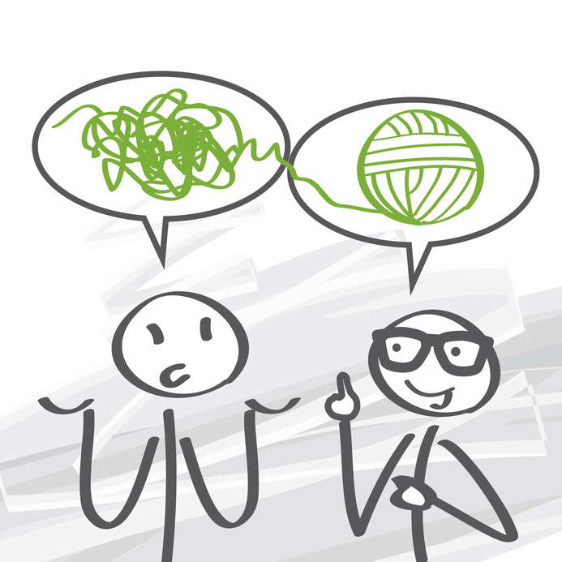
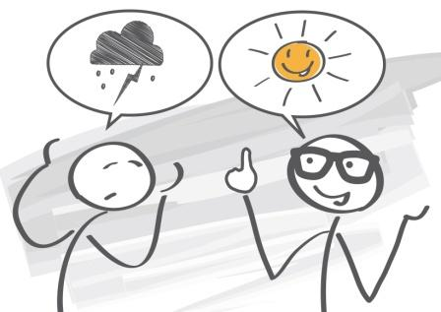
Discussion
Stress
Impacts teacher’s willingness and ability to take on something new
Malleable root cause
Reducing it can enhance likelihood that students receive SEB supports
Introduction | Method | Results | Discussion
Notes:
Madeline
Key Takeaway: Stress can significantly impact whether or not a teacher decides to utilize a proactive classroom management strategy in their classroom.
Stress is a malleable root cause – through programs like ARC, we can intervene to promote teacher wellbeing and thereby increase their willingness/readiness to implement
This will have positive impacts on student outcomes across the board
Significance: First study (that we know of) to examine the impact of intervening to reduce teacher stress on implementation fidelity
Implications:
While the primary purpose of this study was NOT to evaluate the impact of the ARC on student outcomes, the literature suggests that teacher stress affects a wide array of student outcomes as well as the classroom/school climate as a whole
This intervention is about improving teacher wellbeing, which has been linked to :
Teacher delivery of academic supports and EBP’s in addition to behavioral ones
Teacher-student relationship quality
Student stress at school, and ability to respond to student social-emotional needs
Teacher (mental & physical) health → absences
Teacher attrition and turnover
Because teacher wellbeing is tied to various student outcomes as well as school organizational health, there is a need for school districts to create an infrastructure of supports that target teacher wellbeing

Slide 35
Translating to Practice (Generalizable) | Translating to Practice (Context-specific)
Stress is universal Program is not context-specific Open source Being used around the world | Fits well within a school setting (intermediaries) Methodology is translational
Introduction | Method | Results | Discussion

Slide 36
Limitations & Future Directions
Limitations
Small number of participants
Limited to implementer characteristics
Can’t parse out outcome change sequence
Future Directions
Student outcomes
Use as system-wide strategy
Examine contextual factors
Generalize
Introduction | Method | Results | Discussion
Notes:
Madeline
Limitations:
Results should be considered in light of several limitations
Based on a limited number of participants that lack diversity
Did not intervene on contextual factors that would improve teacher wellbeing
Future Research/Next Directions
Should examine additional individual and contextual factors that impact teacher performance and wellbeing
Future studies should include a more diverse sample
Future studies should examine student-level variables (overtime) and outcomes related to improved teacher wellbeing and fidelity of implementation

Slide 37
Learning Objective 3
Learn various strategies that can be used in consultation with teachers to mitigate stress and optimize well-being
Introduction | Method | Results | Discussion
Notes:
Aria

Slide 38
1. Awareness and empowerment through mindfulness based practices
Introduction | Method | Results | Discussion
Notes:
Exercises
Mindful breathing
Mindful attention
Mindful STOP
Stop what you’re doing
Take a few deep breaths
Observe your experience just as it is (thoughts, emotions, body)
Proceed with something that will support you in the moment

Slide 39
2. Choosing to pay attention to the positive and practicing gratitude
Introduction | Method | Results | Discussion
Notes:
Attention training:
Purposefully paying attention to the silver lining
Choosing to see the good in others
Picking a go-to positive thought/image to attend to during a difficult moment
Gratitude practices
Gratitude letter
Gratitude journal

Slide 40
3. Helping and doing good deeds for others
Introduction | Method | Results | Discussion

Slide 41
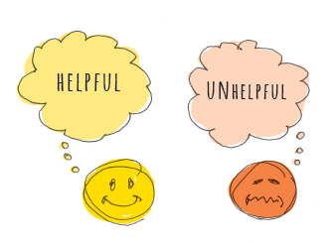
4. Identifying unhelpful thoughts and altering them to be more helpful
Introduction | Method | Results | Discussion
Notes:
Cognitive Restructuring

Slide 42
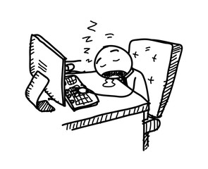
5. Engage in good sleep, exercise regularly, and eat well
Introduction | Method | Results | Discussion

Slide 43
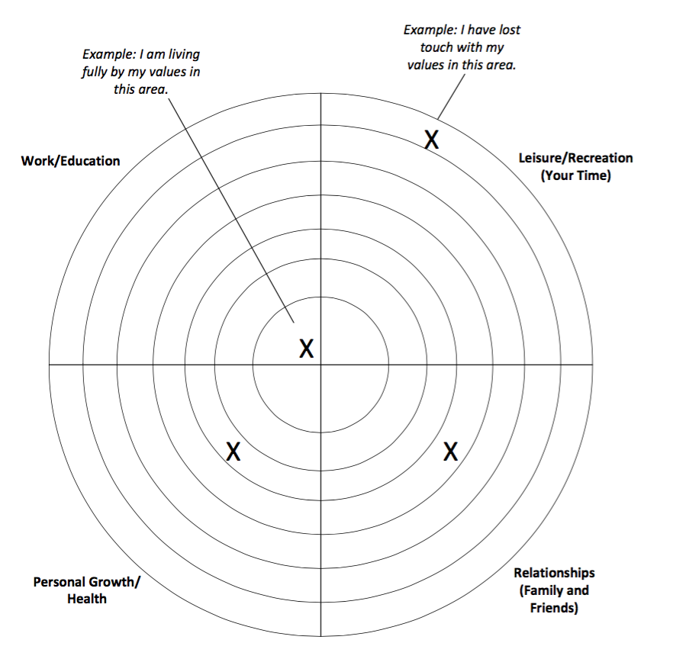
6. Values clarification and commitment
Introduction | Method | Results | Discussion
Notes:
Values Bullseye

Slide 44
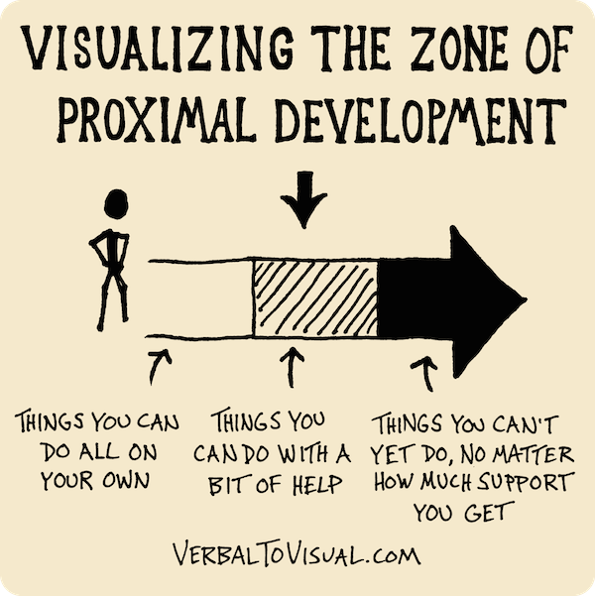
7. Establishing good social support, role model(s), and a mentor (relationships)
Introduction | Method | Results | Discussion

Slide 45
8. Rewarding yourself through relaxation and recreation
Introduction | Method | Results | Discussion

Slide 46
Think-Pair-Share
What are the advantages and drawbacks to this modularized approach?
What specific strategies do think teachers in your school would find most acceptable and most helpful?
Introduction | Method | Results | Discussion

Slide 47
Questions?
Madeline Larson, B.A., lars5424@umn.edu
Aria Fiat, M.A., aefiat@umn.edu
Clayton Cook, Ph.D, crcook@umn.edu

Slide 48
