Slide 1
A Qualitative Comparative Analysis Study of Strategies for the Successful Implementation of Cancer Survivorship Care Plans in Practice
GILLINGS SCHOOL OF GLOBAL PUBLIC HEALTH
Sarah Birken, PhD; Sara Jacobs, PhD; Jamiyla Bolton, BA; Alecia S. Clary, MSW; Miriam Tardif-Douglin, BA; Shampa Bernstein, JD; M. Alexis Kirk, MSPH
North Carolina Translational & Clinical Sciences Institute Grant # 550KR111503
September 8, 2017
4th Biennial Society for Implementation Research Collaborative
Notes:
Thanks so much for having me. I’ll preface by acknowledging my collaborators, experts in QCA. I am not but intuited the benefits of QCA for identifying strategies for SCP implementation. Compare to standard qualitative analysis.

Slide 2
Background
When life is sewn back together, it has changed
Notes:
Start with just a little background: Care for the 15.5 million cancer survivors in the United States is often uncoordinated¹⁰, at times resulting in the duplication or omission of recommended services, poor health outcomes^{19,20}, and significant costs to survivors, caregivers, and the US healthcare system²¹. Cancer survivors are at increased risk for late toxicities of therapy, chronic comorbidities, anxiety, depression, diminished quality of life , and financial distress

Slide 3
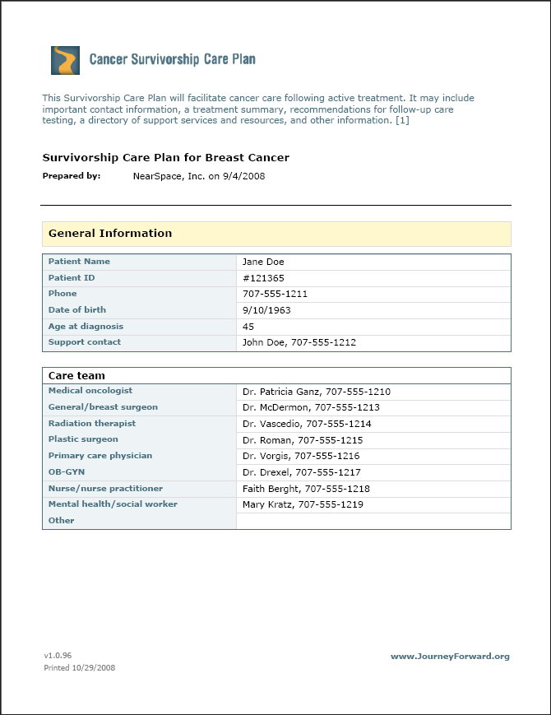
Background
Survivorship care plan core elements:
Summary of the cancer type, treatment, and potential treatment-related late complications
Recommendations for follow-up
Information on secondary cancer prevention and health promotion
Guidance on protection of employment and insurance coverage
Content and local availability of psychosocial resources
Notes:
To address these concerns regarding poor processes of care and outcomes for cancer survivors, many high-profile organizations such as the Commission on Cancer, the largest US cancer program accrediting body, recommend or require the use of SCPs. SCPs are written documents that contain information regarding a survivor’s diagnosis, cancer treatment, and information about what needs to happen after treatment is complete, including preventive, surveillance, and psychosocial services

Slide 4
Rationale
SCP
Survivor
Primary care providers
Cancer care providers
Closing the implementation gap requires identifying effective strategies.
Notes:
The goal of SCPs is to promote coordination and communication among cancer care providers, survivors, and primary care providers, yet SCP implementation is poor: Evidence suggests that cancer care providers often do not develop SCPs; when SCPs are developed, they frequently contain clinically significant errors or omissions²⁶, and they are seldom delivered to survivors or their PCPs^{4,5,27,28} SCP implementation = developed (by some estimates takes up to 2 hours) and delivered to survivors (in visit) and primary care providers (usually fax or email). Closing the implementation gap requires identifying strategies that high-performing cancer programs use to promote SCP implementation.

Slide 5
Objective
To identify strategies for successfully implementing SCPs in practice
Notes:
With that in mind, the objective of this study was to…

Slide 6
Setting
Quality Oncology Practice Initiative (QOPI), a national cancer care quality improvement initiative in which SCP development and delivery rates are suboptimal
600+ participating practices
Notes:
We recruited QOPI practices to participate in the study because their performance data would allow us to sample practices based on their performance with respect to SCP implementation based on these three performance indicators. Based on the CoC standard for 2017, we considered high performers those that responded yes to these questions to 25% or more of their patients.

Slide 7
Data sources
SCP implementation: QOPI performance data include measures of SCP development and delivery, for quality improvement purposes:
Variable | Item | Response format
SCP development | Was SCP completed within 3 months of adjuvant therapy? | Yes/no
SCP delivery to survivors | Was the SCP provided to survivor? | Yes/no
SCP delivery to follow-up care providers | Was the SCP communicated to providers continuing care for the survivor? | Yes/no
Notes:
Outcome variable: We operationalized SCP implementation based on these QOPI performance data items – relating to SCP development (the process of actually populating the document), delivery to survivors (ideally in a visit in which the provider discusses the SCP with the survivor), and dliervy to PCPs

Slide 8
Data sources
Strategies: Interviews with employees in QOPI practices with varied success in implementing SCPs
Notes:
Defining success is subjective and more complicated than we anticipated HIGH PERFORMANCE: intended to anchor at 25% per CoC recommendation

Slide 9
Recruitment
Goal: Identify individuals in QOPI practices who contributed to SCP development and/or delivery
QOPI liaison contacts – snowball
One-week intervals with up to 11 contacts:
Letter
Email
Telephone calls
Notes:
To gain comprehensive understanding of strategies used in sampled cancer programs, our goal was to recruit all individuals in sampled practices. We began with QOPI liaisons and used a snowball approach from there, connecting with potential participants through those contacts and any participants. We recruited using an introductory letter and then iterating between email and telephone calls until we were able to get in touch with potential participants.

Slide 10
Procedure
Interview guide based on Theoretical Domains Framework constructs (e.g., belief about consequences of SCP use, resources and leadership for SCP use) identified in preliminary studies as relevant
2 interviewers from RTI trained by PI
Telephone
30-60 minutes
Audio-recorded
Transcribed verbatim
Notes:
We used an interview guide that was based on constructs that I identified as relevant in one of my preliminary studies (e.g., beliefs about consequences of SCP use). The constructs came from the Theoretical Domains Framework, a comprehensive framework for understanding healthcare providers’ behavior
RAs from RTI conducted the interviews via phone after training. The interviews lasted XX-XX minutes and were audio recorded and transcribed verbatim.

Slide 11
Qualitative comparative analysis
Identifies recipes for success
Principle of equifinality (recipes aren’t one-size-fits all)
Explores complex causality within small samples
Notes:
Our main analytic approach was QCA, which identifies recipes for success, recognizing that what produces successful implementation in one cancer program, for example, might not produce successful implementation in another one – principle of equifinality. To be contrasted with standard quant analyses bc doesn’t as efficiently address equifinality without lots of interaction terms. Also handles small samples (~20, depending on number of conditions included)

Slide 12
Template analysis
Codebook based on Theoretical Domains Framework constructs
Combines a priori and emergent themes
Reconciliation of coding two transcripts among the two interviewers and myself
NVivo
Notes:
But we derived the inputs for QCA from standard qual analysis. This looks a lot like what I usually do in my purely qualitative studies: … As you’ll see, QCA depends on high-quality standard qual analysis, otherwise, garbage in garbage out.

Slide 13
Transformed data for QCA
Case | Condition A: Attitudes about SCPs | Condition B: Beliefs about consequences of SCPs | …etc. | SCP implementation success
Cancer program A | 0 | 0 |  | 1
Cancer program B | 1 | 0 |  | 1
Cancer program C | 0 | 1 |  | 0
…etc
Notes:
This involved dichotomizing both the outcomes (SCP implementation and its sub-outcomes of developpment, delivery) and the determinants. Outcomes from performance data; conditions from interview data

Slide 14
Truth table
Strategy | Successful cancer programs with this strategy | Unsuccessful cancer programs with this strategy
Condition A, not B C | 0 | 3
Conditions A and B, not C | 1 | 2
Conditions A, B and C | 2 | 1
Conditions A and C, not B | 0 | 0
Output: Solutions
Cond 1*not Cond 2* not Cond 3 + not Cond 1* Cond 2*Cond 3
Analysis of truth table
Notes:
Then construct truth table. On left, combinations of conditions that produce outcomes. Analysis produces efficient solutions – the smallest number of strategies that cover all instances of outcome success. This is just an example.

Slide 15
Results

Slide 16
Sample
SCP implementation | Included cancer programs | Total interview participants
Low SCP development Low delivery to survivor Low delivery to PCP | 3 | 4
High SCP development Low delivery to survivor Low delivery to PCP | 2 | 2
High SCP development Low delivery to survivor High delivery to PCP | 7 | 11
High SCP development High delivery to survivor High delivery to PCP | 2 | 3
TOTAL | 14 | 20
Notes:
I mentioned it was more complicated to parse out success vs. lack of success. SCP mplementation is multifaceted, as I’ve mentioned. In practice, lots of ways to skin a cat.
In addition to realizing that not all combinations existed in practice, we realized that we had to move the bar a bit because implementation is so poor – this relates to the point about developing and delivering to PCPs being low-hanging fruit. Initial anchor on CoC; then moving based on data bc practice is so out of whack with requirements – people just aren’t doing this stuff.
I gave you a spoiler alert before when I presented a table similar to this. As it turned out, there were no cancer programs that were delivering SCPs to lots survivors, for example, without developing them frst. This makes sense on a practical level. But we also found that, if cancer programs were delvering SCPs to survivors, they were going to go ahead and send them to PCPs, too, because it often was much easier to deliver SCPs to PCPs – sending a fax or email - than it was to deliver them to survivors, which often required sitting down with survivors in provider visits. Delivering to PCPs was not much additional work. This is why you don’t see the all of the targeted combinations of outcomes here that we wanted to sample.
That said, we conducted 20 interviews in 14 cancer programs. Note interest in second-to-last row.
We’ve done a good job interviewing people in cancer programs with varied SCP implementation success. Note, of course, that we’re primarily interested in this last group – the ones that have been successful at all three parts of SCP implementation.

Slide 17
Qualitative
Variable | High performers | Low performers
Attitudes and consequents | Addresses non-clinical aspects of cancer Meet accreditation standards | Addresses non-clinical aspects of cancer Meet accreditation standards
Champions and leadership | Active leadership Dedicated champion | Passive leadership Emerging champion
Goal and target setting | Prepared for requirements Leveraged requirements to improve survivorship care | Reacted to requirements
Human Resources | Staff dedicated to SCP use Transition to dedicated survivorship program | Staff have many roles Maintain provider from diagnosis through survivorship
Bold denotes differences between high-and low-performers
Notes:
There’s a lot of text here, and the content probably isn’t as important to you as the quantity

Slide 18
Qualitative, cont.
Variable | High performers | Low performers
Informational Resources | Query the EHR/cancer registry for eligible patients Order alert | Maintain an excel spreadsheet of eligible patients Can’t track patients who receive treatment elsewhere Rely on word of mouth
Social support and teamwork | SCP team minimizes interference with the clinical team Everyone is on board with the process One person coordinates SCP delivery across the network but others deliver it | Relies on the clinical team No standardization across the system
Bold denotes differences between high-and low-performers
Notes:
we got lots of juicy information about differences between cancer programs that were high-performers with respect to development and delivery to PCPs at least, and survivors, too when possible.

Slide 19
Qualitative Comparative Analysis
Outcome | Recipe | Raw coverage* | Unique coverage | Coverage overlap
Development | Sufficient staffing * positive staff attitudes about SCPs | .57 (moderate) | .29 (low) | Overlaps substantially with other recipes that lead to effective SCP development
Delivery to survivors | None | n/a | n/a | n/a
Delivery to PCP | Sufficient staffing * sufficient informational resources | .78 (high) | 1 (only recipe for outcome) | None
Strategies for successful SCP implementation:
Underline denotes necessary but insufficient conditions.
*Proportion of practices that used strategy to achieve the outcome
Notes:
QCA results were more sparse. In QCA, we identified strategies for developing SCPs and delivering them to survivors. If you look closely, the recipes look like echoes of the qualitative analysis – attitudes and informational resources and having the staff to do the work.
Sufficient staffing and positive staff attitudes
Note that we identified no strategies for delivering SCPs to survivors.

Slide 20
Discussion
Strategies for successful SCP implementation: the right attitudes and resources to get the job done.
Future research is needed to
Bear out the identified strategies
Understand how high-performers created conditions that facilitated SCP implementation.
Notes:
I won’t say a ton about the content-specific implications of this study because my guess is that there aren’t a lot of people in the crowd who are interested in the implementation of survivorship care plans, specifically. To do due diligence, though, I’ll say that our standard qualitative analysis identified some compelling strategies for successful SCP implementation, including active leadership, dedicated champions, and IT capabilities such as EHR. This is largely consistent with our QCA findings.

Slide 21
Implications for implementation research
QCA is a promising method of identifying equifinal combinations of conditions that represent effective implementation strategies
Notes:
But we already knew that. Back to my question…

Slide 22
Comparing qualitative and QCA
Qualitative | QCA
Nuanced understanding of relationships | Gives relative weight of determinants on outcome, magnitude of comprehensive influence of determinants
Fluid conceptualization of variables | Requires defined categories
Notes:
Gives relative weight of determinants on outcome, allowing us to focus our efforts to promote an outcome (and not worry about things that aren’t as impactful. Contrast to qual, which gives nuanced understanding but not such definitive answers (and there might not be any!!) – if concerns about validity of QCA, wouldn’t want undue focus on particular determiannts
QCA Requires defined categories - Necessary for estimation constraints – balancing sample size against variables
But does this make sense, conceptually, when there’s so much that goes into this? This is the case for our outcomes. Qual offers more fluid conceptualization

Slide 23
Translational implications: the upshot
When you want… | Choose…
Clear attribution of independent variables’ influence on outcomes | QCA
To understand nuances of relationships | Qualitative
When you have… | Choose…
Fluidly defined variables | Qualitative
Well-defined variables | QCA
Invalid QCA??
QCA insuffi-cient without qual?
Notes:
Have to draw a line across every nuanced, fluid variable. Very careful determination of where that line is, but a line none the less. The result may be a shadow of the relationship that we hoped to understand.
Choose methods that are best suited to your research question.
You can’t have your cake and eat it, too:
If you want clear attribution but have fluidly defined variables, QCA results may not be valid. This may be the case in this study. (fuzzy set QCA?)
If you have well-defined variables but want to understand nuances of relationships, QCA may be valid but insufficient without context that qualitative offers.
Importance of solid standard Qual analysis.
Sample size limitations of QCA

Slide 24
Acknowledgements
Leila Kahwati, Senior Advisor, RTI International
Deborah Mayer, Senior Advisor, UNC-CH

Slide 25
References
Birken SA, Deal AM, Mayer DK, Weiner BJ. Determinants of survivorship care plan use in US cancer programs. J Cancer Educ. 2014a;29(4):720-727. doi:10.1007/s12187-014-0645-7.
Birken SA, Deal AM, Mayer DK, Weiner BJ. Following through: The consistency of survivorship care plan use in United States cancer programs. J Cancer Educ. 2014b;29(4):689-697. doi:10.1007/s13187-014-0628-8.
Birken SA, Mayer DK, Weiner BJ. Survivorship care plans: Prevalence and barriers to use. J Cancer Educ. 2013;28(2):290-296. doi:10.1007/s12187-013-0469-x.
Birken SA, Presseau J, Ellis SD, Gerstel AA, Mayer DK. Potential determinants of health-care professionals’ use of survivorship care plans: a qualitative study using the theoretical domains framework. Imp Sci. 2014c;9:167. doi:10.1186/s13012- 014-0167-z.
King N, Symon G (ed.), Cassel C (ed.). Qualitative Methods and Analysis in Organizational Research: A Practical Guide. 12th ed. Thousand Oaks, CA: Sage Publications, Ltd.; 1998:118-134.
Michie S, Johnston M, Abraham C, et al. Making psychological theory useful for implementing evidence based practice: a consensus approach. Qual Saf Health Care. 2005;14(1):26-33. doi:10.1136/qshc.2004.011155.
Salz T, Oeffinger KC, McCabe MS, Layne TM, Bach PB. Survivorship care plans in research and practice. CA Cancer J Clin. 2012;62(2):101-117. doi:10.3322/caac.20142.
Tevaarwerk AJ, Hocking WG, Zeal JL, et al. Accuracy and thoroughness of treatment summaries provided as part of survivorship care plans prepared by two cancer centers. J Oncol. Pract. 2017;JOP.2016.018648. doi:10.1200/JOP.2016.018648.

