Slide 1
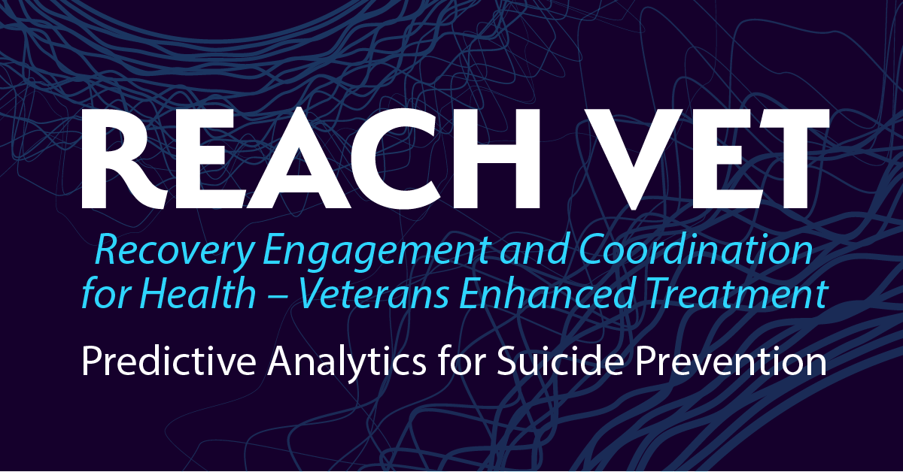
Virtual External Facilitation to Enhance Implementation of Suicide Prevention Outreach in the Department of Veterans Affairs: Partnered Research Outcomes and Perspectives from Various Stakeholders
September 2017

Slide 2
National Implementation of a Suicide Prevention Outreach Program in the Department of Veterans Affairs: Perspectives from an Operational Partner
Aaron Eagan
September 2017

Slide 3
Disclosure
This presentation is based on work supported by the Department of Veterans Affairs, but does not necessarily represent the views of the Department of Veterans Affairs or the United States Government.
The REACH VET program is funded by the Department of Veterans Affairs Office of Mental Health and Suicide Prevention.

Slide 4
What is REACH VET?
Based on the finding that although suicide rates in VHA patients have decreased relative to the US adult population as a whole, they remain high
Supported by senior VA leadership as part of establishing suicide prevention as a major priority
Goes beyond intercepting people on the trajectory towards suicide
Uses predictive models to identify Veterans whose care should be enhanced
Supplements current clinical strategies to identify at-risk Veterans
Complements other VHA initiatives designed to identify new opportunities to enhance care for Veterans

Slide 5
Background: The Predictive Model
Developed by VA and NIMH researchers
Includes clinical and administrative data for each Veteran who utilizes VHA health care services
Calculated Risk
*As compared to overall VHA population
Outcome | Top .1% Top Risk
Suicide (one month) | 33 x
Suicide (one year) | 15 x
Suicide attempt (one year) | 81 x

Slide 6
Preventing Other Adverse Outcomes

Slide 7
Model Predictors
Demographics (e.g., age >= 80, male, married)
Prior suicide attempts
Diagnoses (e.g., depression, diabetes, homelessness)
VHA service utilization (e.g., emergency dept visit, psychiatric discharge)
Medications (e.g., antipsychotics, opioids, statins)
Interactions (e.g., anxiety disorder x personality disorder, widowed x male)
McCarthy et al., 2015

Slide 8

REACH VET is an alert system that provides opportunities for enhanced care
Enhanced Care

Slide 9


REACH VET Steps
REACH VET Coordinators
Access the dashboard
Identify appropriate provider
Communicate with identified provider
Document in EMR
MH and Primary Care Providers
Receive notification about a high risk Veteran
Re-evaluate care
Consider treatment enhancement strategies
Outreach the Veteran
Document in EMR

Slide 10
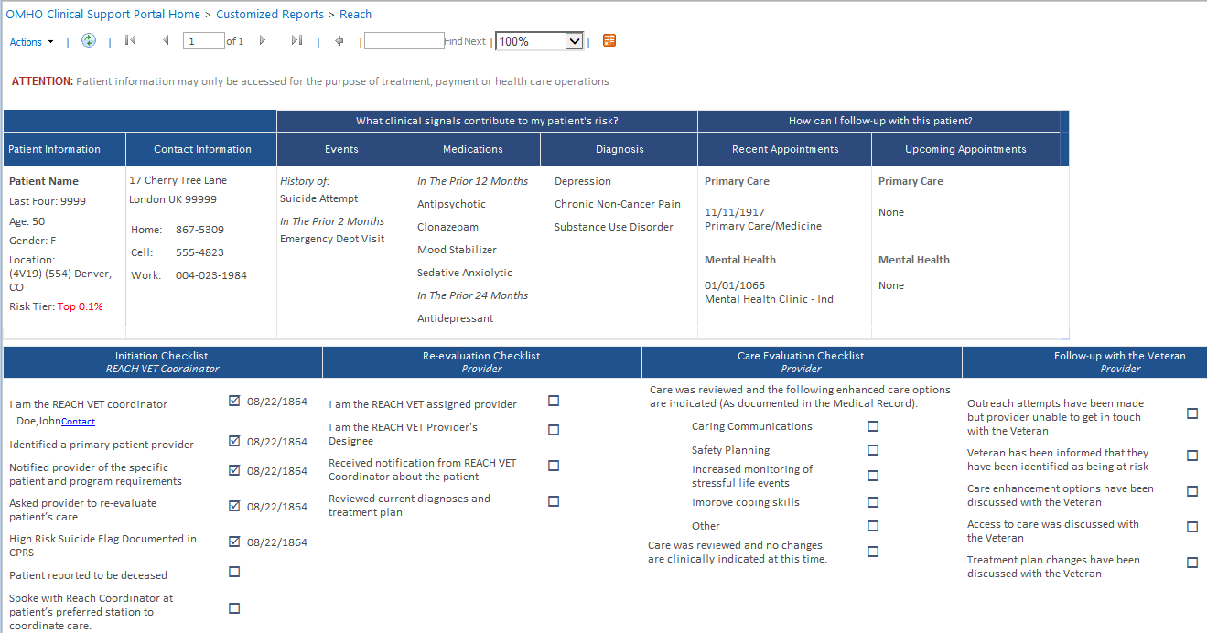
REACH VET Dashboard

Slide 11
Implementation Strategies Used in Initial Roll Out
Strategies | ERIC Implementation Strategies
Creation of dashboard to provide names | Facilitate relay of clinical data to providers
Policy memos | Mandate change
Identification of a coordinator at every VA medical center | Identify and prepare champions
Web-based training | Conduct educational meetings, conduct ongoing training
Creation of educational and support materials | Develop educational materials, distribute educational materials
Reports to VISN leadership on progress | Audit and provide feedback
Technical assistance | Centralize technical assistance
Powell et al., 2015

Slide 12
Events that Impacted Initial Roll Out
National leadership priorities
Changes to implementation plan (e.g., rolling out to facilities gradually)
Changes in resources available

Slide 13
Decision to Use Facilitation
Worked with clinical team and evaluation team to determine how to provide additional assistance to facilities needing help to fully implement REACH VET
Identified facilitation as an implementation strategy used in VA to implement other changes, such as Primary Care-Mental Health Integration
Attended facilitation training with clinical team, which included facilitators, and evaluation team
Collaborated with experts in facilitation to determine plan for facilitation

Slide 14

Experience as Operational Partner

Slide 15
REACH VET Point of Contact
Aaron Eagan, RN, MPH
Office of Mental Health and Suicide Prevention
REACH VET Program Manager
Aaron.Eagan@va.gov

Slide 16
Virtual External Facilitation to Support Implementation of a Suicide Prevention Outreach Program in the Department of Veterans Affairs: Facilitation Activities and a Facilitator's Experience
Kaily Cannizzaro
September 2017

Slide 17
Disclosure
This presentation is based on work supported by the Department of Veterans Affairs, but does not necessarily represent the views of the Department of Veterans Affairs or the United States Government.
The REACH VET program is funded by the Department of Veterans Affairs Office of Mental Health and Suicide Prevention.

Slide 18
What is Facilitation?
Facilitation
A process of interactive problem solving and support that occurs in a context of a recognized need for improvement and a supportive interpersonal relationship
Facilitation can be internal or external to a system. This interactive support process can include a combination of any implementation strategies, and typically bundles multiple strategies as needed
Powell et al., 2015

Slide 19

Facilitation Includes a Number of Strategies
ERIC Implementation Strategies
Assess for readiness and identify barriers and facilitators
Audit and provide feedback
Purposefully reexamine implementation
Develop and implement tools for quality monitoring
Develop a formal blueprint
Conduct a local needs assessment
Facilitation
Technical assistance
Tailor strategies
Promote adaptability
Use data experts
Tailor strategies
Organize clinician implementation team meetings
Conduct local consensus discussions
Use advisory boards and workgroups
Involve executive boards
Conduct ongoing training
Conduct educational meetings
Create a learning collaborative
FACILITATION TOOLBOX

Slide 20
Virtual External Facilitation
External Facilitator
Facilitators
  Kaily Cannizzaro
  Georgia Gerard
  Molly Jankovsky
Clinical experts in suicide prevention
Trained in facilitation
  2 day training with VA experts in facilitation
  Included a virtual component
Site champions
  REACH VET Coordinator
Site Champion

Slide 21
Virtual External Facilitation
Pre-Implementation
Site assessment
Site Visit
Create implementation plan
Training & education
Sustainability
Ongoing support from facilitator
Implementation
Monitoring & improving
Assess strategies & tools and refine plan
Integrate new strategies to maintain
Build stakeholder engagement

Slide 22
Plan for Facilitation

Slide 23
How VISNs and Sites Were Chosen
REACH VET Program Manager offered implementation support to VISNs
VISN Directors and Mental Health Leads determined if they wanted facilitation
Facilitation and evaluation team reviewed data from the REACH VET dashboard to determine which VISNs appeared to need the most assistance
  Focused on one coordinator task and one provider task
Identified the VISNs that would benefit most from facilitation
  Identified sites within the VISN that would benefit most
Worked with evaluation team to determine order of VISNs receiving facilitation
Reviewing sites within each VISN three months before facilitation starts

Slide 24
Preparing for Facilitation
The facilitators are also part of the clinical team for REACH VET
Have helped created and lead
  Online trainings for coordinators and providers
  Videos to demonstrate actions needed in REACH VET
Provide technical assistance via REACH VET helpdesk email
Created a facilitation toolbox customized to REACH VET

Slide 25
Experience as a Facilitator

Slide 26
Contact
Kaily Cannizzaro, PsyD
Rocky Mountain MIRECC for Suicide Prevention
REACH VET Clinical Team
kaily.cannizzaro@va.gov

Slide 27
Randomized Program Evaluation of National Implementation of a Suicide Prevention Outreach Program in the Department of Veterans Affairs: Initial Outcomes and Experiences in Partnered Research
Sara J. Landes
September 2017

Slide 28
Disclosure
This presentation is based on work supported by the Department of Veterans Affairs, but does not necessarily represent the views of the Department of Veterans Affairs or the United States Government.
The REACH VET program is funded by the Department of Veterans Affairs Office of Mental Health and Suicide Prevention.
The REACH VET randomized program evaluation is funded by the Department of Veterans Affairs Health Services Research and Development (HSR&D) Service (Landes, SDR 16-195).

Slide 29
Randomized Program Evaluation
VA Health Services Research and Development (HSR&D) Service published a new announcement for Learning Healthcare Initiative Randomized Program Evaluation
Purpose: to conduct randomized program evaluations of the impacts of new programs or policies that are planned for wide-spread implementation within VA
The request for applications was to support evaluation for a select set of topics recently solicited from VHA operational and program leaders
Clinical implementation of the program or policy is the responsibility of the health care system and relevant program office
Approved concept papers received 6 months of planning funds to develop a full proposal in collaboration with their operational partner

Slide 30
Partnered Research
Given that the grant was funded to evaluate a program being implemented, the evaluation design had to change to accommodate changes in the program
The design started as a stepped wedge
  Changed to a crossover design
  And has since returned to a stepped wedge
The program and evaluation have been impacted by
  Changes in national VA leadership
  Changes in funding
  Changes in the clinical intervention
  Changes in timeline
  Changes in targeted facilities
As the evaluation team, we are documenting these changes to demonstrate how they may have impacted implementation

Slide 31
Randomization
Initially facilities were going to be randomized to when they started implementing REACH VET
  Leadership determined that all facilities needed to implement as soon as possible
Facilities were then going to be randomized to when they would receive implementation support (facilitation)
Revised in the facilitation training; facilitation will now occur in one VISN at a time
  Combining site visits into one trip to reduce burden on facilitators and travel budget
  Working with sites that have similar regional contexts and leadership
Given the resources, 7 VISNs will receive facilitation
  Randomization not appropriate
  PEPReC assigned start times based on mean mental health domain quality standardized scores, which capture facility variation in population coverage, continuity of care, and experience of care

Slide 32
Evaluation
Effectiveness evaluation led by John McCarthy and the Serious Mental Illness Treatment Resource and Evaluation Center (SMITREC), a national VA program evaluation center
  Does REACH VET decrease Veteran suicide?
  What other patient-level impacts are there from REACH VET?
Implementation evaluation led by Sara Landes and the evaluation team funded by HSR&D
  Focused on the implementation outcomes of REACH VET and the effect of the implementation strategies used
  Comparing implementation as usual (IAU) vs. IAU + facilitation

Slide 33
Implementation Outcomes
Reach: the proportion of patients identified at each facility who receive the REACH VET intervention
Adoption: proportion of facilities that implement REACH VET and the proportion of mental health and primary care providers in each facility that participate
Implementation fidelity: whether facilities implemented all components of the intervention as directed by the memos and the REACH VET program website
Cost of implementation: document the amount of effort and time needed to offer virtual external facilitation
Cost of the intervention: document the amount of effort and time needed to implement REACH VET activities
Organizational context: Organizational Readiness for Change survey
Barriers, facilitators, experience of facilitation process: done via qualitative interviews

Slide 34
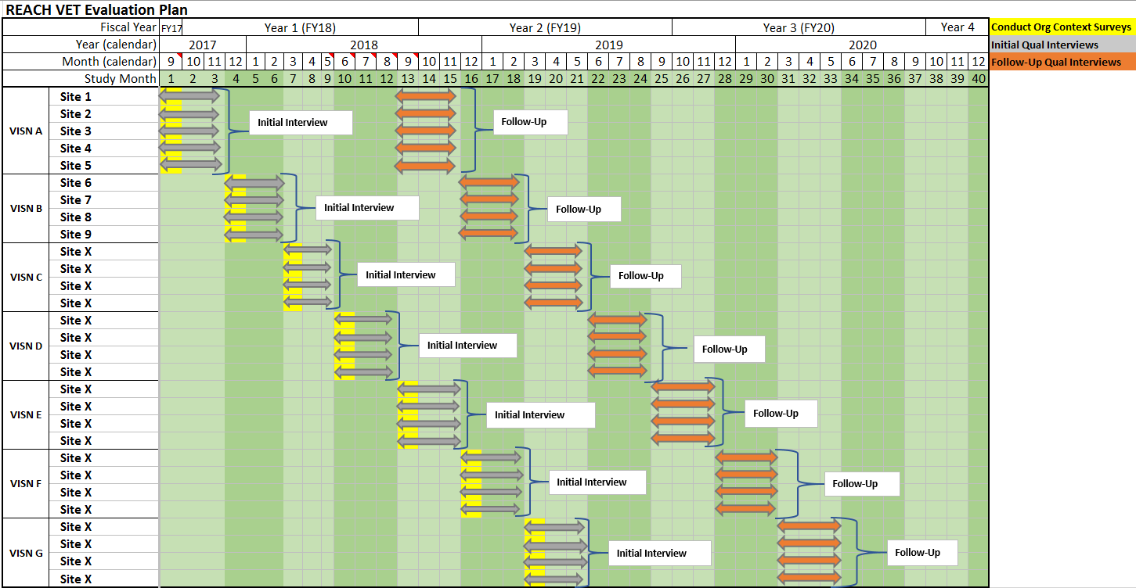
Evaluation Plan

Slide 35
Measuring Facilitation
Using the same methods as other Behavioral Health QUERI projects using facilitation to allow comparison across projects
Time and activity tracking logs (Bauer et al., 2017)
Facilitator debrief interviews
  Includes a Key Events Template (Woodward et al., 2016)

Slide 36
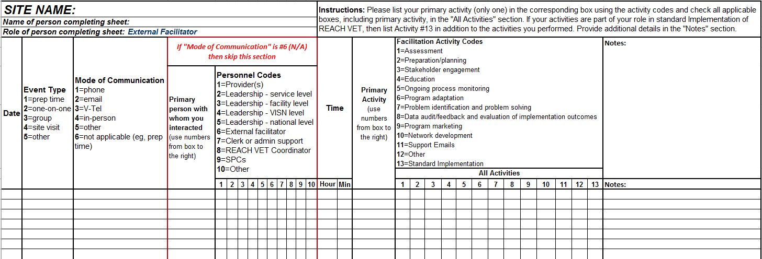
Facilitator Time & Activity Log
Example of activity definition
Assessment/Evaluation of implementation or outcomes activities include:
Working with facilities or REACH VET Coordinators to identify current practice patterns for REACH VET implementation, for the purposes of reducing adverse outcomes, including suicide in Veterans.
Conducting audit and feedback using REACH VET dashboard data.
Conducting interviews to gather information about strengths, barriers, and creative solutions utilized in overcoming these barriers .
Assessing organizational context/environment, including needs, barriers, and key stakeholders in REACH VET implementation (e.g., resources, data capture systems, culture, leadership, etc.).

Slide 37
Facilitator Debrief Interviews
Questions vary based on pre-implementation (before and after sites identified) and implementation/post-implementation
All include the Key Events Template

Slide 38
Implementation/post-implementation Questions
What sites are you currently working with?
[For new sites] What do you know about those sites so far (e.g., leadership, barriers, facilitators)?
What is the status of REACH VET implementation at those sites?
What kinds of activities have you been doing during the last week?
Have you had any special meetings or site visits during the last week?
  If yes, please give me a “blow by blow” account.
    What was the process for the visit?
    Who attended meetings?
    What were the barriers and facilitators you identified?
    What did you do as a facilitator at the meeting?
    What follow-up plans do you have?
Has anything significant happened in regards to REACH VET in the last week?
  Dashboard changes
  Policy changes
  Other program changes
Have any of the events from the key event menu happened (if site specific, note which site)? [For the interviewer, if already mentioned, just note, such as facilitator activities.]

Slide 39
Key Events Template
Personnel Changes
Staff Added/Lost (any relevant personnel that are not in formal leadership; e.g., clerks, providers, quality assurance manager)
Leadership Turnover (lost/added)
Facilitator Activities
Implementation Planning Event (e.g., kickoff event, site visit)
General Education About an Intervention (e.g., educating a general group of stakeholders)
Mentoring of Providers on the Intervention (e.g., specific coaching and supervision of clinicians implementing the intervention)
Data Gathering and Feedback (audit & feedback in any form)

Slide 40
Key Events Template cont.
Clinic Events
Leaders Communicating with Staff (when leaders communicate or share messages, either formally or informally, with their staff about the intervention or events/initiatives that might affect the implementation of the intervention)
Physical Space Changes (e.g., providers move locations, televideo equipment is secured and installed)
Referral Process Changes (e.g., a new flow of how patients get from point A to B is initiated; formal or informal)
Broader Context Events
Regional Events (e.g., VISN telehealth initiative rolls out)
Organizational Events (e.g., new VA secretary; it is possible that the regional and organizational events may be lumped together for certain healthcare systems. For VA, they remain separate.)
External Events (Events external to the organization; e.g., political changes, impactful current events)

Slide 41
Where Are We Now
~ 6 months in after full implementation
Identifying ~6,700 Veterans per month
Identified more than 20,000 unique Veterans to date
Launched CPRS template that substantially decreases administrative burden
Started external facilitation with first VISN

Slide 42
Experience as a Researcher

Slide 43
Translating research into practice
Practice or policy implications for stakeholders
Using feedback from the field during implementation can result in an improved intervention
  For example, the REACH VET dashboard has been revised based on user feedback for an improved experience
Generalizable practice or policy implications
Partnered research where the operational partner and evaluation team work together from the beginning allows for co-creation of a design that both addresses the practical needs of operational or clinical stakeholders and allows for the design of the most rigorous evaluation possible given those needs
  This may be an example of work that is closer to what Kitson and colleagues (2017) call for in their description of a KT Complexity Network

Slide 44
Contact
Sara J. Landes, PhD
South Central MIRECC, Central Arkansas Veterans Healthcare System
REACH VET Evaluation Lead
sara.landes@va.gov

Slide 45
Discussant
JoAnn Kirchner
September 2017

Slide 46
Kitson et al. (2017) KT Complexity Network
PI
I
PI
Problem Identification
Community
I
Implementation
Health
KC
KC
Knowledge Creation
Government
E
Evaluation
E
Education
KS
Knowledge Synthesis
Research
KS

Slide 47
Extra Slides with Quotes if Needed for Audience Questions

Slide 48
Veteran Outreach
Increasing Awareness of Risk
“So far I only have one Veteran on the REACH VET program. I educated him about how Veterans are “selected” for the designation... I then educated about how this would impact his treatment by pointing out he was already engaged as we would want him to be. Veteran expressed gratitude for the increased awareness of suicidality as well as for the CAMS group, which he finds very helpful. I think it’s a relief for him to know we are all aware of his risks – seems to have increased his accountability!”
- Lexington, KY

Slide 49
Veteran Outreach
An Opportunity for Re-engagement
“I explained REACH VET by informing [the] Veteran he had been identified as being at higher risk due to diagnosis and inpatient VA utilization. Veteran responded by stating he felt he could benefit from mental health counseling to assist with depression and anxiety issues.”
- Lexington, KY

Slide 50
Veteran Outreach
An Opportunity for Re-engagement
“Yesterday, I nudged a provider to “try one more time.” He [the Veteran] was just discharged from a non-VA BH facility; he AGAIN told her no….but about an hour later he called back and scheduled an appointment!”
- Alexandria, LA

Slide 51
Veteran Outreach
Enhancing Care
“Regarding the REACH VET program… most of [our providers] conveyed that the Veterans “were grateful for the extra concern.” In many instances, Veterans did engage in enhanced services, and clinicians felt that the additional attention and interventions were beneficial. One of our therapists noted that the Veterans on her panel were “optimistic and grateful for the additional attention.”
- Erie, PA

