Slide 1
Systems Consultation: A Novel Implementation Strategy for Adopting Clinical Guidelines for Opioid Prescribing in Primary Care Andrew Quanbeck, Ph.D. University of Wisconsin-Madison Assistant Professor- Dept. of Family Medicine and Community Health Research Scientist- Center for Health Enhancement Systems Studies Honorary Associate- Dept. of Industrial & Systems Engineering

Slide 2
Thank You!
National Institute on Drug Abuse (1R34DA036720-01A1; 1K01DA039336-01 )
UWHealth Primary Care Clinics
Advisory panel
Jane Ballantyne, MD Paul Batalden, MD
Roger Chou, MD Perry Fine, MD
David Gustafson, PhD Jonas Lee, MD
Dennis McCarty, PhD Beth Potter, MD
John Frey, MD
Research team: Randall Brown, Bri Deyo, Aleksandra Zgierska, Bobbie Johnson, Esra Alagoz, Nora Jacobson Jim Robinson, Wen-Jan Tuan, Lynn Madden

Slide 3
Declaration
I have a shareholder interest in CHESS Mobile Health, a web-based health care technology company that has developed software for patients and family members struggling with addiction.

Slide 4
Aims of the Project
Goal is to improve patient safety by instituting a set of universal precautions for opioid prescribing in primary care based on leading clinical guidelines
R34 grant mechanism is specifically for testing the feasibility, acceptability, and preliminary effectiveness of novel implementation strategies in preparation for larger trials

Slide 5
Background & Motivation
Source: Opioid Prescriptions Dispensed by US Retail Pharmacies. IMS Health, Vector One
Notes:
This chart illustrates the steady rise in the number of opioids dispensed between 1991 and 2011. The total amount reached its apex in 2011 before starting to level off and move in the other direction.

Slide 6
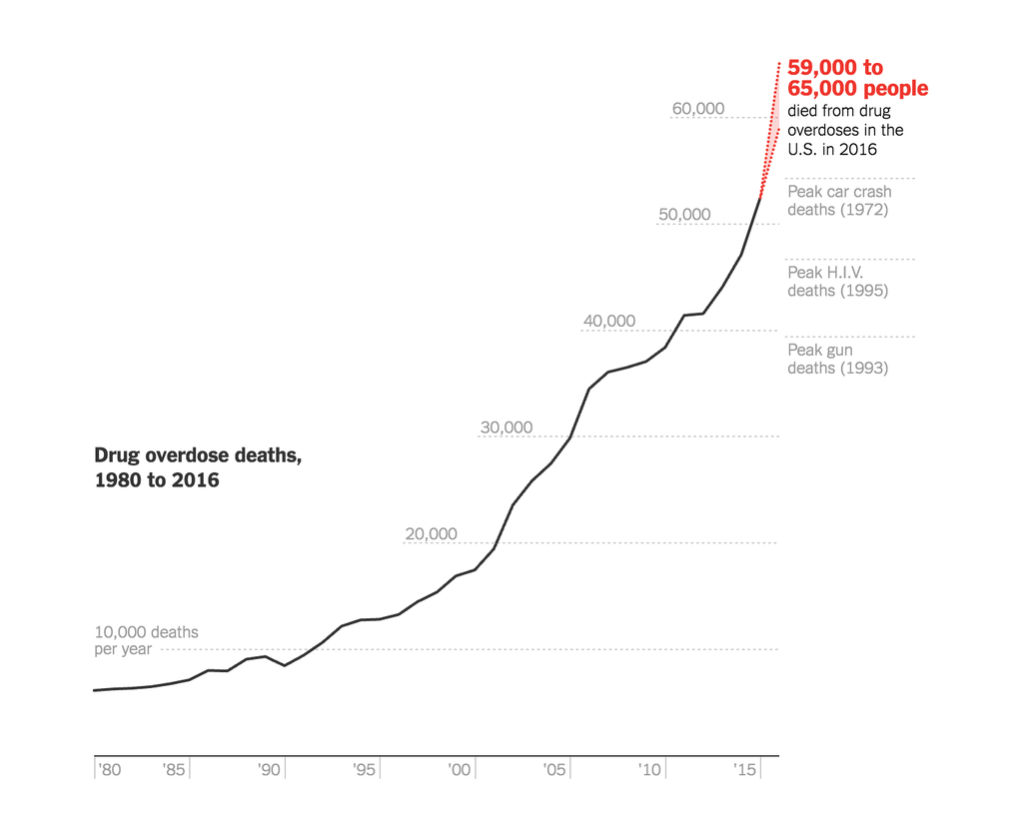
Background & Motivation
Opioid prescribing rates may be on the decline, but overdose rates are at all-time highs.
Source: New York Times infographic, June 5, 2017
Notes:
Even though prescribing rates have slowed, overdose death rates are still rising. I picture this as a wave that crested for 20 years and is now in its crash phase. We still have a long way to go to ride this wave out.

Slide 7
Background & Motivation
Risk of overdose is directly correlated with morphine equivalent daily dose (Dunn et al., 2010).
Notes:
This chart is especially relevant. It shows the increased risk of overdose as a function of morphine equivalent daily dose. Dose reduction was a key theme of our project. There is talk in the implementation science world about the need to de-implement ineffective or harmful practices. Prescription opioids may represent the largest de-implementation effort seen to date in healthcare.

Slide 8
Clinical guidelines
Consensus is emerging around guidelines, with CDC guidelines leading the way
Notes:
So you can think of this as a de-adoption project but it’s hard to replace something with nothing. So, first things first- we had to determine “what” we would implement. We selected the guidelines written by Roger Chou and colleagues and published in the Journal of Pain. A version of this guideline later became the basis for the CDC guidelines for opioid prescribing.
Opioid management remains a controversial issue but consensus has been emerging about a few basic ideas. 1st, high doses are to be avoided (above 90 MEDD). 2nd, there needs to be frequent follow up, screening, and monitoring with patients, and a lot more communication around risks and benefits of opioid therapy.
All the information you would ever need is in this guideline, but it isn’t presented in a digestible format – it’s a 40 page journal article with 25 recommendations. So our goal was to compress and prioritize the guideline using a systematic process.

Slide 9
Multidisciplinary workgroup
Clinical guideline writers (Chou, Fine, Ballantyne)
Primary care physicians (Frey, Lee, Potter)
Systems engineering / implementation research (Gustafson, Batalden)
Addiction and drug policy (McCarty)
Notes:
We were able to recruit 3 of the 5 lead authors of this guideline to participate, including the lead author, Roger Chou. We teamed the guideline writers with 3 primary care physicians, 2 systems engineers / implementation specialists, and a national leader in drug policy.

Slide 10
1. Choose participants 2. Develop a straw model through telephone interviews 3. Convene the group and revise the straw model 4. Design case scenarios 5. Enumerate the model 6. Identify sources of conflict 7. Average the smaller differences 8. Report the group’s judgment
Integrated Group Process (Gustafson et al., 1993)
Notes:
And, we put this group to work at something called the integrated group process.
I’m not going to go through all the steps; but the goal of it was to produce a succinct checklist that prioritizes the recommendations and shapes them into a step-by-step process for implementation in clinical settings.

Slide 11
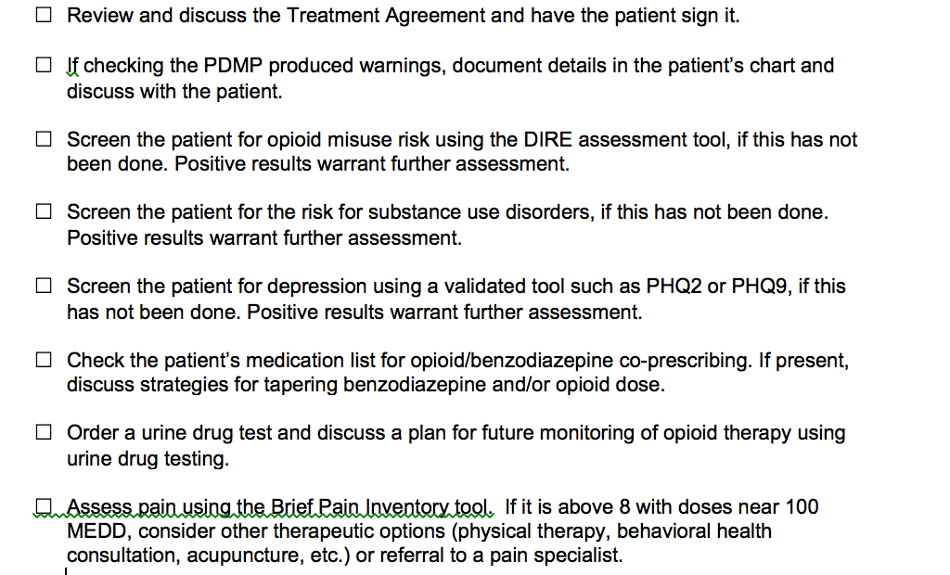
Checklist-based implementation guide
Notes:
This is the checklist we produced by applying the process. It has 8 items on it. Remember we started with 25 recommendations.
That is no accident; there is a rule of thumb called the “magic number 7, plus or minus 2.” That rule says that you can’t give people more than about 7 pieces of information to process. That is the information processing channel capacity you are dealing with when you are working with human beings.
We encourage clinics to pick one element to start on. One thing at a time. Doing everything can feel overwhelming. Don’t get discouraged. Just get started.

Slide 12
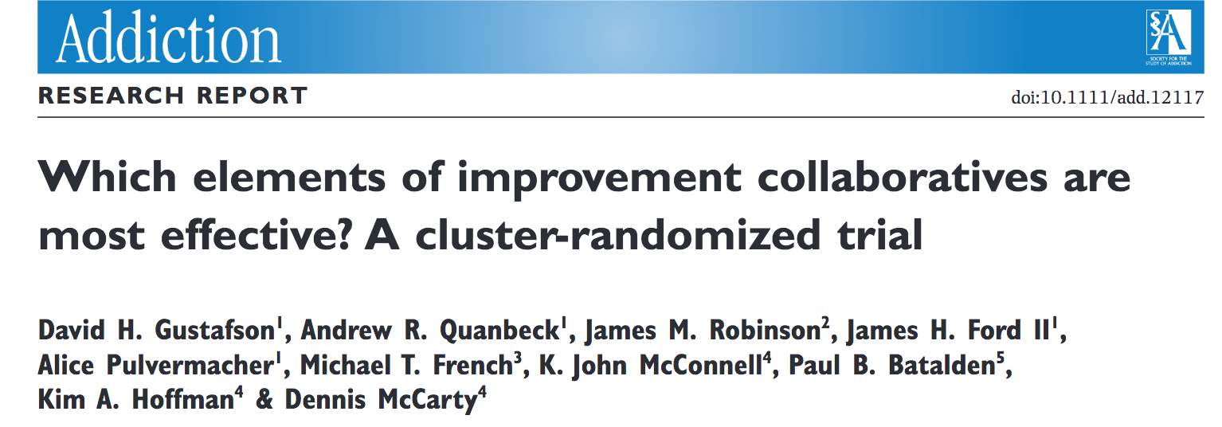
Implementation Strategy: Systems Consultation
Based on an organizational coaching model proven cost-effective in a randomized trial of 201 addiction treatment organizations (Gustafson et al., 2013) and used by ~ 4000 organizations nationwide
Notes:
The implementation strategy we used is based on a QI model named NIATx that has been widely adopted in the addiction treatment industry. There isn’t time to describe it in detail but this paper provides a good summary.
Based on success in addiction treatment, NIATx showed promise for opioid prescribing in primary care. But some translation and adaptation would be needed to make the model work for a new problem in a new setting.
One of the things we learned through the studies of NIATx in addiction treatment is that peer coaching was the most cost effective way to disseminate the NIATx model.
So, from the beginning, we decided that coaching was going to be a centerpiece of the implementation strategy.

Slide 13
Key features of implementation strategy
The implementation guide produced via the integrated group process was central to the approach
We trained and deployed physician peer coaches/consultants to work with clinics in implementing the guide
We used evidence-based implementation tools from systems engineering (e.g., flowcharting, Plan-Do-Study-Act change cycles) to modify workflows and facilitate adoption of the guide

Slide 14
Coaching model
The usual approach to organizational change in healthcare: surveillance, scolding, etc.
Our approach: self determination theory
Competence
Relatedness
Autonomous motivation
Perspective, empathy, and homophily
Notes:
Both of the peer coaches were faculty in the UW Dept. of Family Medicine. Both are family care MDs with hands on experience with opioid prescribing, and they both deal with addiction as well. They have experienced this difficult issue firsthand with their patients .
We felt it was essential to our coaching model that the change agents were MDs- since the practices that we are seeking to change in this project require the involvement of prescribing MDs.

Slide 15
Implementation approach
Create a detailed flowchart of Rx refill process and monitor incoming requests
Compare patient’s chart to checklist and set up appointments to take steps towards risk minimization
Select new opioid patients carefully, and set a clinic-wide expectation to limit dose to 100 MEDD
Use skill and clinical judgment in dealing with inherited and/or high-dose patients.
Notes:
We had clinics focus on the prescription refill process. Every clinic has a system for doing this, and refill requests are happening daily, so there is always a place to start.
There are some who might say that our goal should be “no more opioids for chronic pain!” That is a hard way to do an implementation project for a few reasons.
You simply can’t cut patients off opioids cold turkey. There are serious withdrawal effects and patients need to be tapered off opioids very slowly.
You never know when the next patient with chronic pain is going to show up. It’s unpredictable and thus hard to plan a project around initiation of new patients.
More judicious initiation of new prescriptions is certainly a goal that most everyone in the medical community shares. The idea is to start building a system. The very act of building the system, and the thought and effort involved in doing so, is likely to force lasting behavior change around prescribing. I don’t think you can just tell somebody to do something or to stop doing something and expect anything to happen. But if instead you start DOING something concrete, that is the path towards behavior change.

Slide 16
Methods
The study compares 4 intervention clinics to 4 control clinics in a randomized matched-pairs design.
Each systems consultation team worked with clinics on implementing the guidelines during a 6-month intervention comprised of 3 monthly site visits and 3 telephone / videoconferences.
Quantitative outcomes are reported using difference-in-differences analysis.
Qualitative methods included ethnographic field techniques, focus groups, and interviews.

Slide 17
Feasibility
From a pool of 13 clinics, we randomly approached 7 clinics to recruit 4 intervention clinics (3 clinics declined, 2 citing “lack of time” and 1 “leadership turnover”).
Baseline prescribing rates (% of patients on long-term opioid therapy): 1.4% in control clinics, 1.2% in intervention clinics
Each clinic designated a project team consisting of 6-8 staff members, each with at least 1 primary care physician, RN, MA/LPN, and administrative staff member.
All 4 clinics completed all scheduled activities over 6 months, and attendance at intervention meetings was 83%.

Slide 18
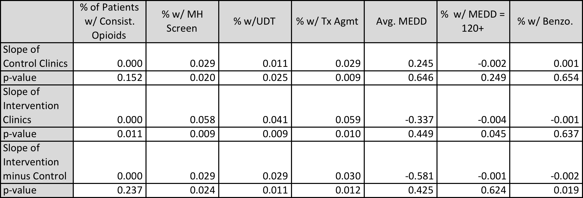
Effectiveness (6 months)

Slide 19
Maintenance (12 months)

Slide 20
Average MEDD of Consistent Opioid Users by Intervention Month Average opioid MEDD has decreased significantly for intervention clinics. MEDD for control clinics has increased, but not significantly so. The difference between intervention and controls is significant.

Slide 21
% Consistent Opioid Users with Mental Health Screen by Intervention Month MH screening outcomes for intervention and control clinics both show significant improvement. Rate of improvement for intervention clinics is significantly greater.

Slide 22
% Consistent Opioid Users with Treatment Agreement by Intervention Month Tx Agmt outcomes for intervention and control clinics both show significant improvement. There is somewhat greater improvement for intervention clinics.
p = 0.146

Slide 23
% Consistent Opioid Users with Urine Drug Screen by Intervention Month UDT outcomes for intervention and control clinics both show significant improvement. There is somewhat greater improvement for intervention clinics.
p = 0.153

Slide 24
Qualitative results – key adaptations
Our implementation strategy morphed into a “team coaching” model to mirror the structure of primary care work teams
Lunch hour is the only time this kind of teamwork can be done (the four-hour meeting is a non-starter in primary care)
We leveraged workflows employed for other chronic conditions that are hallmarks of primary care, including hypertension and diabetes.

Slide 25
Acceptability
More than 80% of staff respondents agreed or strongly agreed with the statements:
“I am more familiar with guidelines for safe opioid prescribing”
“My clinic’s workflow for opioid prescribing is easier”
The approach seemed to provide the kind of help that primary care clinics want and need (Heard at the last site visit: “You’re leaving already?”)

Slide 26
Limitations
Relatively small sample of clinics (4), staff (28), and patients (~500) in a single health system
Pragmatic study design
Secular trends were evident

Slide 27
Next steps: scaling up to affect population health
Aspirus
Aurora Health Care
Bellin Health
Gundersen Health System
ProHealth Care
ThedaCare
Notes:
Results comprise preliminary data for a randomized trial that will deliver discrete components of the implementation strategy to provide the optimal level of support clinics need. We will be working across a number of different health systems in an attempt to move the needle on overdose deaths in the state of Wisconsin.

Slide 28
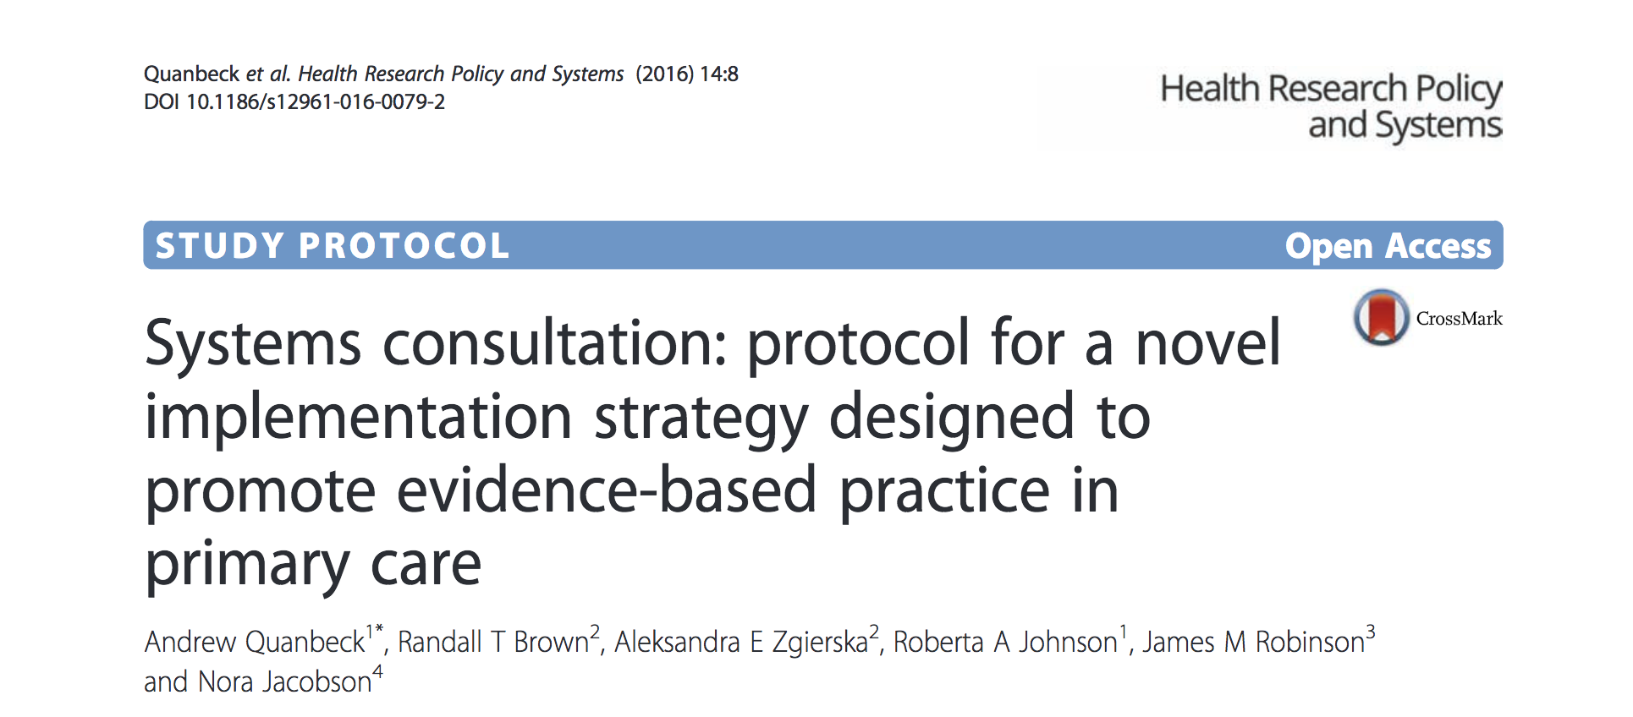
For more information, see:
Notes:
We have published the study protocol if you’re interested in learning more about the study. Results will be published soon!

Slide 29
Practical implications: primary care
Translating Research Into Practice
The opioids crisis developed over a generation, and there’s no quick fix in sight
Nevertheless, progress can be made when clinical guideline writers, primary care physicians, and implementation scientists work to tackle the problem together
Actively seeking to understand diverse perspectives- in a systematic way- is key!
Notes:
We’ve known for a long time that we have a huge problem on our hands- now we need to figure out what to do about it. After working with doctors on the front lines for several years it’s clear that this is going to require a long-term sustained effort. I don’t think we can afford to take any hard line stances on opioids one way or another. Anyone who views the issue in those terms I don't think really understands the problem. There has to be a balance. That balance can be struck when implementation scientists help broker conversations between clinical guideline writers and primary care physicians- the people whose works is affected, and who need to do the work of implementation.

Slide 30
Practical implications: generalizable
Translating Research Into Practice (cont.)
Clinical guidelines are ubiquitous in healthcare (and mostly ignored)
The project provides a model for clinical experts and implementation scientists to work together in promoting implementation of clinical guidelines
Up next: reducing unnecessary pediatric surgeries
Clinical guideline writer (university-based faculty physician)
Implementation researcher (yours truly)
Primary care physicians (community based)
Notes:
Our approach was applied to clinical guidelines for opioid prescribing in primary care. But it can be readily applied to other clinical guidelines, which exist all over healthcare. I’m currently in the process of adapting the implementation strategy and applying it to reducing unnecessary pediatric surgeries, working with a physician from the medical school at the University of Wisconsin. We are finding that the approach ports over quite readily. This physician really seems excited about the using the process. Engaging MDs in implementation research has not always been the easiest thing to do, and this seems to be an approach that has the potential to be applied in other settings.

Slide 31
Thank you!
Andrew Quanbeck
University of Wisconsin-Madison
arquanbe@wisc.edu

