Slide 1

Using Behaviour Change Theory and Techniques in Implementation Research
Marie Johnston
Aberdeen Health Psychology Group
m.johnston@abdn.ac.uk
SIRC 2017 Seattle

Slide 2
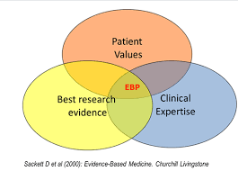

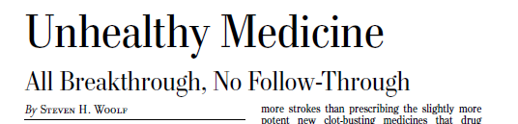
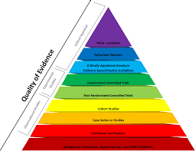
The importance of implementing evidence

Slide 3
Implementation and Behavioural Science
Implementing research evidence into practice depends on changing human behaviour – at individual, organisational, community and population levels (NICE, 2007).
Behaviour of managers, service commissioners and providers, ancillary, administrative and technical staff, policy-makers, politicians amongst others
Evidence about behaviour change in systematic reviews published in the Cochrane Library (Cochrane Effective Practice and Organisation of Care Group (EPOC); www.cochranelibrary.com.
practice only changes when people do things differently

Slide 4
Outline
What does behavioural science bring?
  Theories explaining behaviour
    Why are theories of behaviour important?
    Which theories are useful?
  Methods of changing behaviour
    Behaviour change techniques
How can Theory and Methods be linked?

Slide 5
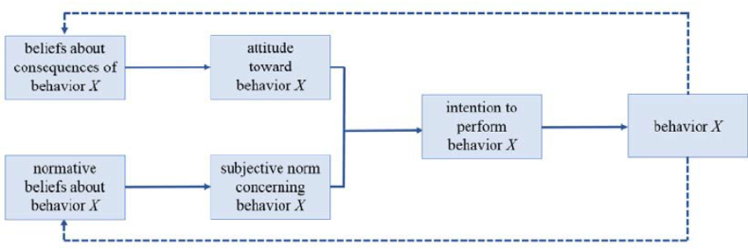
Why is theory important?
Anecdote: a recent conference paper
Intensive study of physical activity in a large sample of women
health motivations did not predict physical activity
no theoretical background
1934 La Piere demonstrated that attitudes did not predict behaviour
1950s -1960s academic crisis that attitudes did not predict behaviour
1975 Theory of Planned Behaviour
study failed to benefit from evidence and (old) theory
LaPiere, R.T. (1934). Attitudes v’s actions. Social Forces, 13, 230-7
Fishbein, M., & Ajzen, I. (1975). Belief, Attitude, Intention, and Behavior: An Introduction to Theory and Research. Reading, MA: Addison-Wesley

Slide 6

Theories of behaviour:
Problem of ‘intuitive’ ‘common-sense models
  Different people and disciplines have different intuitions
    Common sense isn’t ‘common’
  ‘implicit’ theory –
    not explicit and so not tested - and so persist
    don’t benefit from evidence
  Often ‘wrong’ e.g. importance of
    knowledge/education
    conscious decisions
I have an idea about what influences behaviour!
‘too many cooks spoil the broth’ | ‘many hands make light work’
‘absence makes the heart grow fonder’ | ‘out of sight, out of mind’

Slide 7

Contrasting ‘intuitive’ and theory-based interventions dentists’ clinical behaviour (placing fissure sealants on children’s teeth)
Intuition: professional behaviour determined by education
Theory:
Behaviour influenced by rewards
Mean % children with sealant per dentist
RESULTS:
Rewards increased rate of Evidence-based practice (fissure sealants)
Education had no effect
Clarkson, J. E., Turner, S., Grimshaw, J. M., Ramsay, C. R., Johnston, M., Scott, A., ... & Pitts, N. B. (2008). Changing clinicians’ behavior: a randomized controlled trial of fees and education. Journal of Dental Research, 87(7), 640-644.
ERUPT
Evidence from Research Used in Preventive Treatment

Slide 8
Theories of behaviour

Slide 9
What should be included?
Easy to fix on one explanation for behaviour and forget others
What should be included?
Theoretical Domains Framework (TDF)
  Consensus about main factors influencing implementation behaviours
Michie, S., Johnston, M., Abraham, C. et al.(2005). Making psychological theory useful for implementing evidence based practice: a consensus approach. Quality and safety in health care, 14(1), 26-33.
Atkins, L., Francis, J., Islam, R., O’Connor, D., Patey, A., Ivers, N., … Michie, S. (2017). A guide to using the Theoretical Domains Framework of behaviour change to investigate implementation problems. Implementation Science, 12, 77. https://doi.org/10.1186/s13012-017-0605-9

Slide 10
What should be considered?
Theoretical Domains Framework (for implementation)
Major Theorists*
intention
environmental constraints
skills
anticipated outcome (or attitude)
self-efficacy
norms
emotion
self-standards
Motivation and goal priorities
Beliefs about EBP/guidelines
Knowledge and skills
Beliefs about consequences
Beliefs about capabilities
Social influences
Emotion
Cognitive processing: memory, attention and decision processes
Physical context and resources
Action planning
Nature of the behaviour
* Fishbein M, Triandis HC, Kanfer FH, et al. Factors influencing behaviour and behaviour change. In: Baum A, Revenson TA, Singer JE, eds. Handbook of health psychology. Mahwah, NJ: Lawrence Erlbaum Associates, 2001:3–17

Slide 11
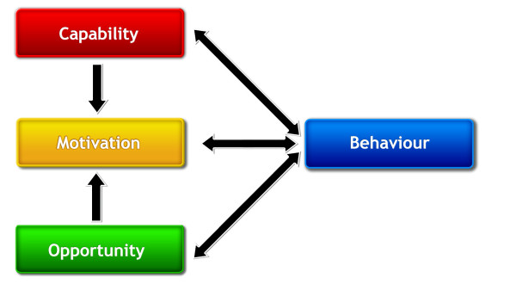
What is necessary and sufficient in a theory?
Major theorists¹
  the skills necessary to perform the behaviour.
  strong intention to perform the behaviour;
  no environmental constraints that make it impossible to perform the behaviour; and
COM-B²
1. Fishbein M, Triandis HC, Kanfer FH, et al. Factors influencing behaviour and behaviour change. In: Baum A, Revenson TA, Singer JE, eds. Handbook of health psychology. Mahwah, NJ: Lawrence Erlbaum Associates, 2001:3–17
2. Michie, S., van Stralen, M. M., & West, R. (2011). The behaviour change wheel: a new method for characterising and designing behaviour change interventions. Implementation science, 6(1), 42.

Slide 12
Which theories are useful?
Modifiable
  Some theories explain but do not suggest how to change behaviour
    e.g. personality
Non-volitional as well as volitional
  Constraints
  Automatic processes
Predict
  Which theories predict implementation behaviours?
Eccles M, Grimshaw J, Walker A, Johnston M, Pitts N. Changing the behavior of healthcare professionals: the use of theory in promoting the uptake of research findings. J Clin Epidemiol. 2005;58(2):107–12

Slide 13


Testing multiple theoretical models in Implementation research: Evidence
Evidence-based clinical behaviours:
in general practice dentists and doctors
  taking dental radiographs
  performing dental restorations
  placing fissure sealants
  managing upper respiratory tract infections without prescribing antibiotics
  managing low back pain without ordering lumbar spine x-rays
Theories
  Theory of Planned Behaviour √
  Social Cognitive Theory √
  Learning Theory √
  Implementation Intentions √
  Precaution Adoption Process√
  --------------------------------------
  Common Sense Self-Regulation
  (Knowledge)
Eccles, M. P., Grimshaw, J. M., MacLennan, G., Bonetti, D., Glidewell, L., Pitts, N. B., ... & Johnston, M. (2012). Explaining clinical behaviors using multiple theoretical models. Implementation Science, 7(1), 99.

Slide 14
What predicted clinical behaviours?
Knowledge
Attitudes/Risk Perception
Outcome expectancy
Intentions
Self-efficacy (Perceived control)
Action plans
Habits
Eccles, M. P., Grimshaw, J. M., MacLennan, G., Bonetti, D., Glidewell, L., Pitts, N. B., ... & Johnston, M. (2012). Explaining clinical behaviors using multiple theoretical models. Implementation Science, 7(1), 99.

Slide 15
What predicted clinical behaviours? pre- and post- intention
Knowledge
Attitudes/Risk Perception
Outcome expectancy
Intentions
Self-efficacy (Perceived control)
Action plans
Habits
Motivating
(Pre-intentional)
Action Regulation
(Post-intentional)
But is all behaviour ‘intentional’?
e.g. habits
Eccles, M. P., Grimshaw, J. M., MacLennan, G., Bonetti, D., Glidewell, L., Pitts, N. B., ... & Johnston, M. (2012). Explaining clinical behaviors using multiple theoretical models. Implementation Science, 7(1), 99.

Slide 16


‘Dual Processing’: Two systems influencing behaviour
Reasoning
Reflective
Deliberative
Slow
Impulsive
Automatic
Associative
Fast
Habits beat reasoning!
I don’t intend to eat chocolate cake … oops!

Slide 17
What predicted clinical behaviours? reasoning and automatic systems
Knowledge
Attitudes/Risk Perception
Outcome expectancy
Intentions
Self-efficacy (Perceived control)
Action plans
Habits
Reasoning, Slow,
System
Automatic,
Fast,
System
Eccles, M. P., Grimshaw, J. M., MacLennan, G., Bonetti, D., Glidewell, L., Pitts, N. B., ... & Johnston, M. (2012). Explaining clinical behaviors using multiple theoretical models. Implementation Science, 7(1), 99.

Slide 18
What predicted clinical behaviours? reasoning and automatic systems
Knowledge
Attitudes/Risk Perception
Outcome expectancy
Intentions
Self-efficacy
Action plans
Habits
Reasoning, Slow,
System
Motivation
Action Regulation
Automatic,
Fast, System
Eccles, M. P., Grimshaw, J. M., MacLennan, G., Bonetti, D., Glidewell, L., Pitts, N. B., ... & Johnston, M. (2012). Explaining clinical behaviors using multiple theoretical models. Implementation Science, 7(1), 99.

Slide 19
Illustration summarising the evidence: GPs managing patients with diabetes
Motivation: ‘thinking’ – deliberative, slow
Action Regulation: ‘goals and planning’ - deliberative, slow
Prompted by situational factors: ‘automatic’ – impulsive, fast
‘prescribing X has good results’
‘I’m in favour of prescribing X’
‘I intend to prescribe X’
‘I have a clear plan about how to prescribe X’
‘I always prescribe X (appropriately)’
‘I prescribe X (appropriately)’
Beliefs
Attitudes
Intentions
Plans
BEHAVIOUR
Habits
Intentions work via planning to change behaviour and planning can work by developing habits
Presseau, J., Johnston, M., Heponiemi,... & Hawthorne, G. (2014). Reflective and automatic processes in health care professional behaviour: a dual process model tested across multiple behaviours. Annals of Behavioral Medicine, 48(3), 347-358.
Potthoff, S., Presseau, J., Sniehotta, F. F., Johnston, M., Elovainio, M., & Avery, L. (2017). Planning to be routine: habit as a mediator of the planning-behaviour relationship in healthcare professionals. Implementation Science, 12(1), 24.

Slide 20
Illustration summarising the evidence: reducing chocolate consumption
Motivation: ‘thinking’ – deliberative, slow
Action Regulation: ‘goals and planning’ - deliberative, slow
Prompted by situational factors: ‘automatic’ – impulsive, fast
‘its bad for me to eat too much chocolate’
‘I would like to eat less chocolate’
‘I intend to eat less chocolate’
‘I have a clear plan about how to reduce my chocolate consumption’
‘I only eat chocolate at weekends’
‘I eat the right amount of chocolate’
Beliefs
Attitudes
Intentions
Plans
BEHAVIOUR
Habits

Slide 21
Methods of changing behaviour

Slide 22
Methods of changing behaviour
Behaviour change techniques (BCTs)
  smallest component of an intervention compatible with retaining the postulated active ingredients, and
  used alone or in combination with other BCTs.
Involves
  Context e.g.
    Home
    Clinic …
  Delivery e.g.
    Face-to-face, Group
    Letter, Email …
  Intensity e.g.
    Once vs monthly
    1 minute vs 3 hours
Michie, S., Richardson, M., Johnston, M., Abraham, C., Francis, J., Hardeman, W., ... & Wood, C. E. (2013). The behavior change technique taxonomy (v1) of 93 hierarchically clustered techniques: building an international consensus for the reporting of behavior change interventions. Annals of behavioral medicine, 46(1), 81-95.

Slide 23

Behaviour Change Technique Taxonomy v1 (BCTTv1)
Methods
  Literature searching
  Delphi studies with experts in behaviour change
  Reliability testing
  Open-sort study
  Advice from International Advisory Board
Result
  93 BCTs with labels and definitions
  Grouped in 16 clusters
https://www.ucl.ac.uk/health-psychology/bcttaxonomy

Slide 24
BCTTv1: Example of Groupings
2. Feedback and monitoring
BCTTv1: Examples of Groupings
2.1. Monitoring of behavior by others without feedback
2.2. Feedback on behaviour
2.3. Self-monitoring of behaviour
2.4. Self-monitoring of outcome(s) of behaviour
2.5. Monitoring of outcome(s) of behavior without feedback
2.6. Biofeedback
2.7. Feedback on outcome(s)
“Establish a method for the person to monitor and record their behavior(s) as part of a behavior change strategy”

Slide 25
BCTTv1: Example of Groupings
1. Goals and planning
BCTTv1: Example of Groupings
1.Goals and Planning
1.1. Goal setting (behavior)
1.2. Problem solving
1.3. Goal setting (outcome)
1.4. Action planning
1.5. Review behavior goal(s)
1.6. Discrepancy between current behavior and goal
1.7. Review outcome goal(s)
1.8. Behavioral contract
1.9. Commitment
Set or agree on a goal defined in terms of the behavior to be achieved

Slide 26
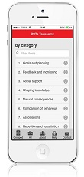

Behaviour Change Technique Taxonomy v1 (BCTTv1): Resources
  93 BCTs with labels and definitions
  Grouped in 16 clusters
  Online training
  App
https://www.ucl.ac.uk/health-psychology/bcttaxonomy
https://www.ucl.ac.uk/health-psychology/bcttaxonomy/BCT_app1
https://www.ucl.ac.uk/health-psychology/bcttaxonomy/Online_training

Slide 27



Improving the delivery of behaviour change techniques
Health Behaviour Change Competency Framework:
Competences to deliver interventions to change lifestyle behaviours that affect health
10/11/2010
Diane Dixon and Marie Johnston
Competency
Development of a framework to describe competencies for health behaviour change
For Scottish Government
www.healthscotland.com/documents/4877.aspx

Slide 28
Health Behaviour Change Competency Framework
www.healthscotland.com/documents/4877.aspx

Slide 29
Linking Theory and Methods of Behaviour Change

Slide 30
Choosing BCTs:
3 routes to behaviour change the MAP*
By
Motivation: increase the desire to do the behaviour
Action Regulation: enable the motivated person to self-regulate toward the behaviour
Prompts & Cues: trigger automatic, associative processed without requiring conscious motivation or self-regulation
Beliefs
Attitudes
Intentions
Plans
BEHAVIOUR
Habits
‘intention by-pass’
*Dixon, D. & Johnston, M. (2010) the Health behaviour change Competency Framework http://www.healthscotland.com/documents/4877.aspx

Slide 31
Behaviour Change Techniques:
Examples for the MAP
Motivation
Persuasive argument
Pros and cons
Incentive
Health consequences
Social and environmental consequences
Emotional consequences
Anticipated regret
Action Regulation
Problem solving/coping planning
Goal setting (outcome)
Behavioral contract
Review behavior goal(s)
Feedback on behavior
Self-monitoring of outcome of behavior
Prompts & Cues
Restructuring the physical environment
Distraction
Reward
Punishment
Habit formation
Prompts/cues
Classical conditioning
Michie S, Richardson M, Johnston M, Abraham C, .., Wood CE. (2013). The Behavior Change Technique Taxonomy (v1) of 93 hierarchically clustered techniques: building an international consensus for the reporting of behavior change interventions, Annals of Behavioral Medicine, 2013;46(1): 81-95. doi: 10.1007/s12160-013-9486-6

Slide 32
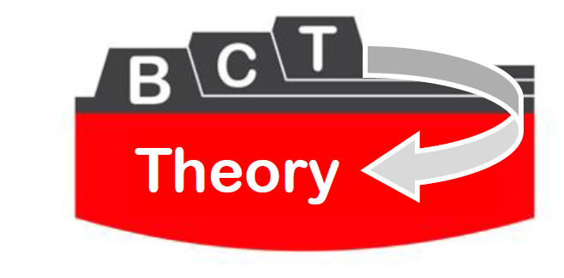













From theory-inspired to theory-based interventions:
Linking behaviour change techniques to their mechanisms of action
Susan Michie¹
The team: Marie Johnston², Alex Rothman³, Mike Kelly⁴ & Marijn de Bruin², Rachel Carey¹ & Lauren Connell¹
@SusanMichie
@UCLTaxonomy
¹
²
³
⁴

Slide 33
‘Theory and Techniques’ project
Aim:
To identify hypothesised links between intervention content (i.e. BCTs) and
  (i) mechanisms of action (MoAs) and
  (ii) theories
Two data sources:
  Published reports of interventions
  Expert consensus
Notes:
We are interested in examining the thinking of behaviour change experts, as a step towards future work to examine empirically tested link. We can make no inferences as to the empirically demonstrated statistical association of these links.

Slide 34
Linking Behaviour change techniques with Mechanisms of Action
Mechanism(s) of Action (MoAs)
Behaviour Change Techniques (BCTs)
Behaviour
Process(es) through which a BCT affects behaviour
Potentially active ingredients within an intervention designed to change behaviour
Anything a person does in response to internal or external events

Slide 35
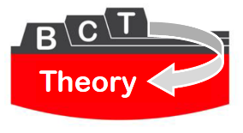

Mechanisms of Action
Mechanisms of Action
BCT
Behaviour
MoAs from Theoretical Domains Framework¹
Knowledge
Skills
Social/Professional Role & Identity
Beliefs about Capabilities
Optimism
Beliefs about Consequences
Reinforcement
Intentions
Goals
Memory, Attention & Decision Processes
Environmental Context & Resources
Social Influences
Emotion
Behavioural Regulation
Additional MoAs from 83 theories of behaviour change²
15. (Societal) Norms
16. Subjective Norms
17. Attitude towards the Behaviour
18. Motivation
19. Self-image
20. Needs
21. Values
22. Feedback Processes
23. Social Learning/Imitation
24. Behavioural Cueing
25. General Attitudes/Beliefs
26. Perceived Susceptibility
¹Cane et al., 2012; ²Michie et al., 2014
Notes:
In order to identify a broad range of potential mechanisms of action, we included: (i) the 14 theoretical domains described in the Theoretical Domains Framework and (ii) the 12 most frequently occurring mechanisms of action derived from a set of 83 behaviour change theories identified in a systematic review.

Slide 36
Two studies linking BCTs and Mechanisms of action
Methods
Study 1 published reports: Links between BCTs and mechanisms of action (MoAs) hypothesised by authors identified from 277 published intervention papers.
Study 2 expert consensus: BCT-MoA links hypothesised by 105 international behaviour change experts.

Slide 37
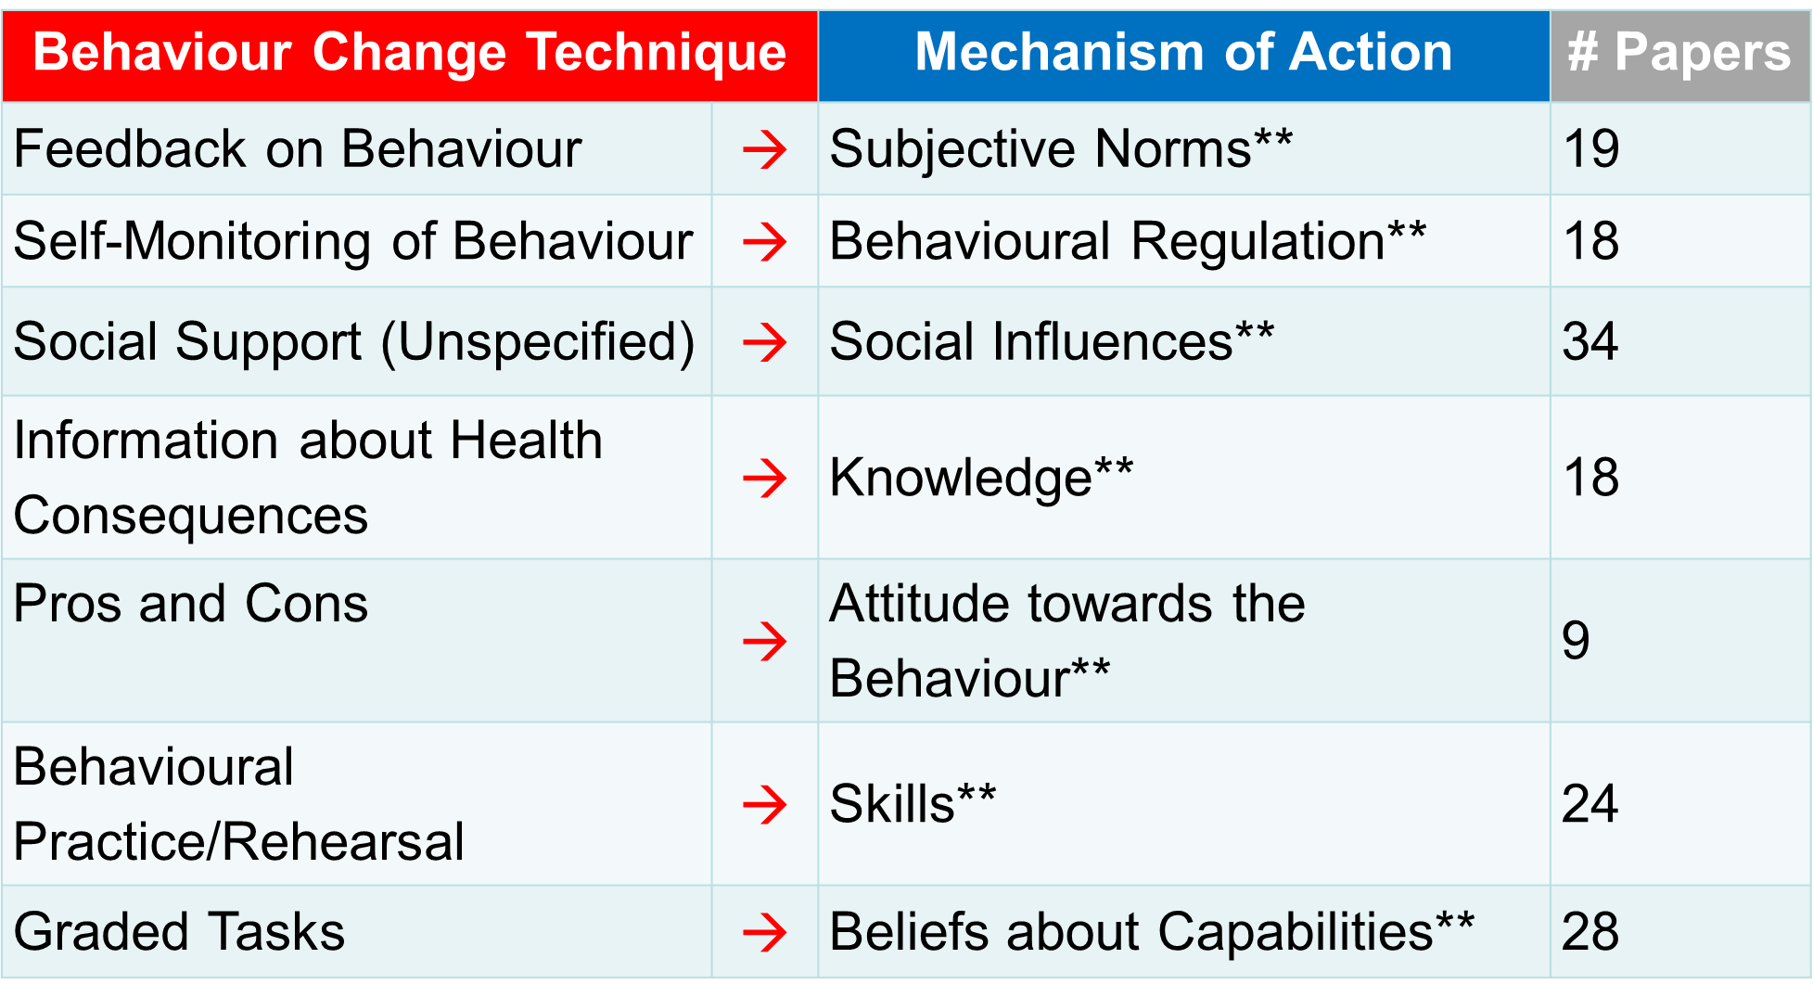

Links between Behaviour change Techniques and Mechanisms of Action found in published reports: Examples of significant links

Slide 38
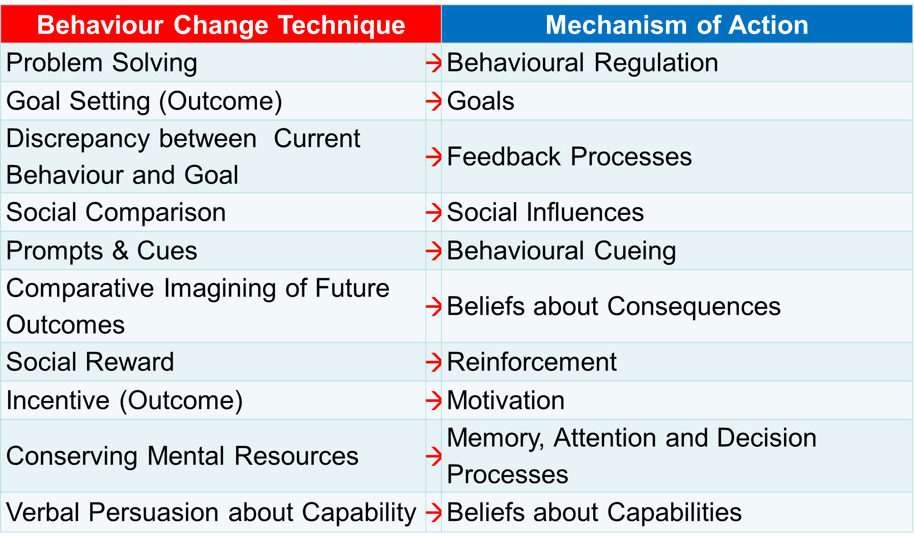
Links between Behaviour change Techniques and Mechanisms of Action:
100% of experts agreed on the following 10 links
STUDY TWO
Expert-Agreed Explicit Links

Slide 39
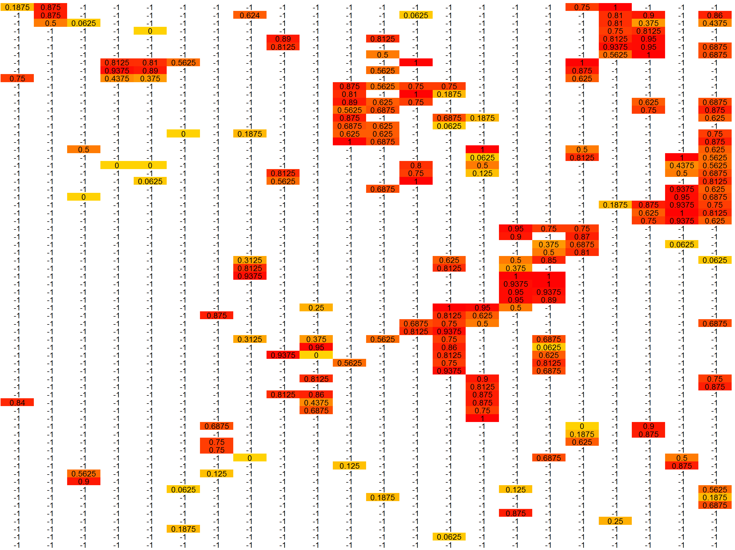
Triangulation: Heat Map
Data are represented in heat maps to indicate the frequency with which each BCT is hypothesised to link to each MoA
Behaviour Change TechniquesBCTs
Mechanisms of Action: MoAs
Notes:
The heat map clusters:
BCTs (rows) that are more similar in terms of the pattern of linked/unlinked MoAs
MoAs (columns) that are more frequently linked overall

Slide 40

Future Challenge: ‘the big question’
Human Behaviour-Change Project
When it comes to behaviour change interventions:
what works,
compared with what,
for what behaviours,
how well, for how long,
with whom, in what setting,
and why?

Slide 41





The Human Behaviour-Change Project
Participating organisations
A Collaborative award funded by the
www.humanbehaviourchange.org
@HBCProject

Slide 42
Primary goal of the
Human Behaviour-Change Project
To develop an understanding of human behaviour to answer variants of the ‘big question’
When it comes to behaviour change interventions:
what works,
compared with what,
for what behaviours,
how well, for how long,
with whom, in what setting,
and why?

Slide 43
Challenges in addressing the big question
Challenge | Solution
Research conduct: Diversity of research methods and topics; inconsistency and incompleteness in reporting | Ontology of behaviour change interventions

Slide 44
Challenges in addressing the big question
Challenge | Solution
Research conduct: Diversity of research methods and topics; inconsistency and incompleteness in reporting | Ontology of behaviour change interventions
Resource limitations: Insufficient human resources to manage the increasing volume of research | Use of automated literature searching and study feature extraction

Slide 45
Challenges in addressing the big question
Challenge | Solution
Research conduct: Diversity of research methods and topics; inconsistency and incompleteness in reporting | Ontology of behaviour change interventions
Resource limitations: Insufficient human resources given the increasing volume of research | Use of automated literature searching and study feature extraction
Research findings: Complex evidence base equivocal or contradictory findings, variety of behaviours, interventions, contexts etc; complexity of interactions between intervention components | Use of machine learning and reasoning algorithms for evidence synthesis User interface to simplify understanding of evidence

Slide 46
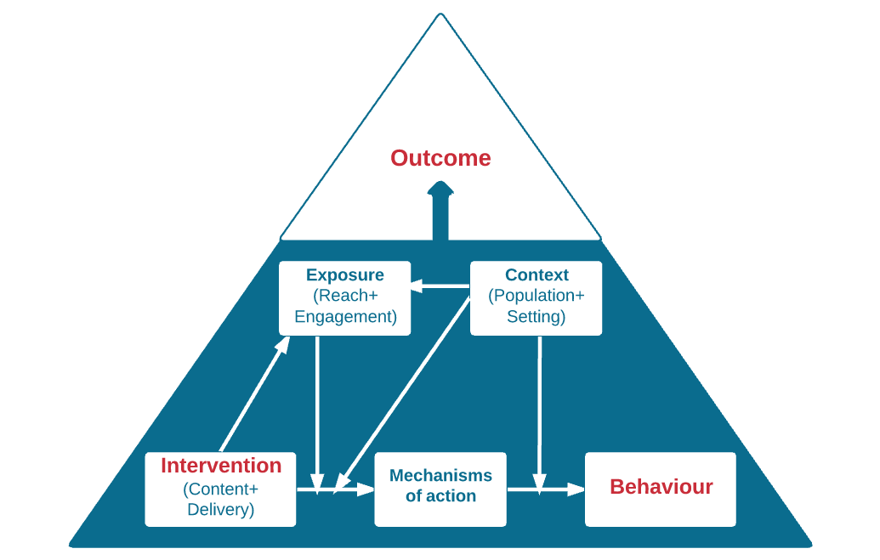
The Human Behaviour-Change Project
Top-level of Behaviour Change Intervention Ontology
Notes:
Needs to be changed to the updated version

Slide 47
The Human Behaviour-Change Project
The collaboration
 | Behavioural science | System architects | Computer science
Grant-holders | Susan Michie¹ (PI) Robert West¹ Marie Johnston³ Mike Kelly⁴ | James Thomas¹ | John Shawe-Taylor¹ Pol MacAonghusa²
Researchers Consultants | Ailbhe Finnerty¹ Marta Marques¹ Emma Norris¹ Alison Wright¹ | Alison O’Mara-Eves¹ Gillian Stokes¹ Patrick O'Driscoll¹ Janna Hastings Julian Everett | Debasis Ganguly² Lea Deleris²
¹UCL ²IBM Dublin ³Aberdeen University ⁴Cambridge University

Slide 48


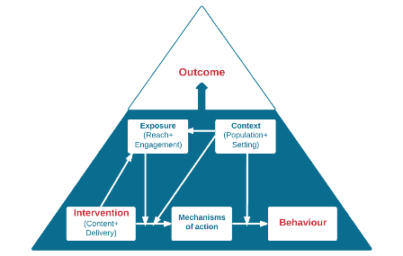
Summary and Conclusions
Implementation involves behaviour change
  Danger of intuitive models
Behavioural science offers:
  Theory explaining behaviour
    Theoretical domains framework
    COM-B
    Dual processing
  Methods of changing behaviour:
    Behaviour Change Techniques – Taxonomy BCTTv1
    MAP of the 3 routes to behaviour change
    Links to mechanisms – heat maps
    Competency
Challenges!!
Beliefs
Attitudes
Intentions
Plans
BEHAVIOUR
Habits
MAP

Slide 49
Using Behaviour Change Theory and Techniques in Implementation Research
Thank you
Marie Johnston
Aberdeen Health Psychology Group
m.johnston@abdn.ac.uk
SIRC 2017 Seattle

Slide 50
http://dissemination-implementation.org/viewAll_di.aspx

