Slide 1
Using Direct Observation to Guide Implementation Facilitation
Bo Kim PhD^{1,2}, Christopher J. Miller PhD^{1,2}, Mark S. Bauer MD^{1,2}, A. Rani Elwy PhD^{1,3}
(1) HSR&D Center for Healthcare Organization and Implementation Research; Veterans Health Administration
(2) Department of Psychiatry; Harvard Medical School
(3) Department of Health Law, Policy, and Management; Boston University School of Public Health

Slide 2
Implementation
through
facilitation
Formative
evaluation
Direct observation

Slide 3
Formative Evaluation (FE)
From Stetler et al. (2006):
“A rigorous assessment process designed to identify potential and actual influences on the progress and effectiveness of implementation efforts”
Challenge – inaccurate but still widespread view that “FE involves only qualitative research or that it is not rigorous”

Slide 4
Thoroughly collect implementation data
Implementation
through
facilitation
Formative
evaluation
Mixed-methods
direct observation
Systematically feed the data back to shape implementation

Slide 5
Direct Observation
“…observation is about stalking culture in the wild…[it] is a strategic method… [which] puts you where the action is and lets you collect data . . .” (Bernard, 2002)
World Health Organization’s Kikwawila Study Group, 1994:
To understand
processes, events, norms, values, and social context
human behavior that is largely unknown (hidden) or complex
conceptions and attitudes of study group and their points of view
To complement other findings
To help researcher formulate ideas in local “language”

Slide 6
Four types of FE (Stetler et al., 2006):
Understanding practice
Detailing activities
Monitoring impact
Explaining results
Developmental
Implementation-focused
Progress-focused
Interpretive
To understand
processes, events, norms, values, and social context
human behavior that is largely unknown (hidden) or complex
conceptions and attitudes of study group and their points of view
To complement other findings
To help researcher formulate ideas in local “language”

Slide 7
Acknowledgements
McCullough MB, Kim B, Ruben M, Wang S, Fix GM. Direct Observation Methods for Health Services and Implementation Research. AcademyHealth Annual Research Meeting, Boston, 26-28 June 2016.
The contents do not represent the views of the U.S. Department of Veterans Affairs (VA) or the United States Government.
This work is supported by VA HSR&D Quality Enhancement Research Initiative QUE 15-289, Behavioral Health QUERI Program, “Hybrid Controlled Trial to Implement Collaborative Care in General Mental Health.”
Authors have no conflicts of interest.

Slide 8
Implementation Study: Multi-site stepped-wedge controlled trial to implement interdisciplinary team-based behavioral health care at VA medical centers
Conceptual Framework: Integrated Promoting Action on Research Implementation in Health Services (i-PARIHS) framework (Harvey & Kitson, 2016)
Facilitation Model: Blended external-internal facilitation (Kirchner et al., 2014)

Slide 9
Population Involved
Three external facilitators (EFs)
Each EF worked with the internal facilitator (IF) at three sites (N=9 sites)
Each site’s interdisciplinary team of providers
Each site’s additional stakeholders including leadership

Slide 10
Observation Parameters
DOMAIN: information that observation is providing
OBSERVER: who is observing
SUBJECT: who is being observed
MODE: how observation is being carried out
TIMING: when observation is being carried out
DATA COLLECTION AID
FORMATIVE FEEDBACK MECHANISM

Slide 11
Observation Domains Considered
Site Characteristics
Implementation Status
Resource Utilization
4-6 weeks prior to year-long
implementation
facilitation
During year-long
implementation
facilitation
-Semi-structured
conversations
-Multi-modal
observations
during site visit
-Count and
progress check of
redesigned processes
-Multi-modal
observations
of team meetings
-Time-motion
log of facilitation
activity
-Comparison
across sites

Slide 12
Observation Domain: Site Characteristics
Developmental
OBSERVER | EF
SUBJECT | IF, team, stakeholders
MODE | EF holds phone/video/on-site conversations with IF, team, and stakeholders
TIMING | Pre-implementation period of approximately six weeks

Slide 13
Observation Domain: Site Characteristics
Developmental
DATA COLLECTION AID: i-PARIHS-based conversation guide
FORMATIVE FEEDBACK MECHANISM: Baseline site assessment report
Sample questions:
What external context factors (e.g., high rates of homelessness
in surrounding area, recent layoffs among the patient population)
should we be aware of?
Is there a history of multidisciplinary collaboration among staff?
If so, how would you describe it?
What is your experience with, or knowledge of,
the interdisciplinary team-based care initiative?

Slide 14
Observation Domain: Implementation Status
Implementation-focused
Progress-focused
OBSERVER | EF, IF
SUBJECT | EF, IF, team
MODE | EF joins IF-led team meeting over video
TIMING | IF leads team meeting weekly; EF joins regularly for first half of year-long implementation period, then with tapering frequency over second half

Slide 15
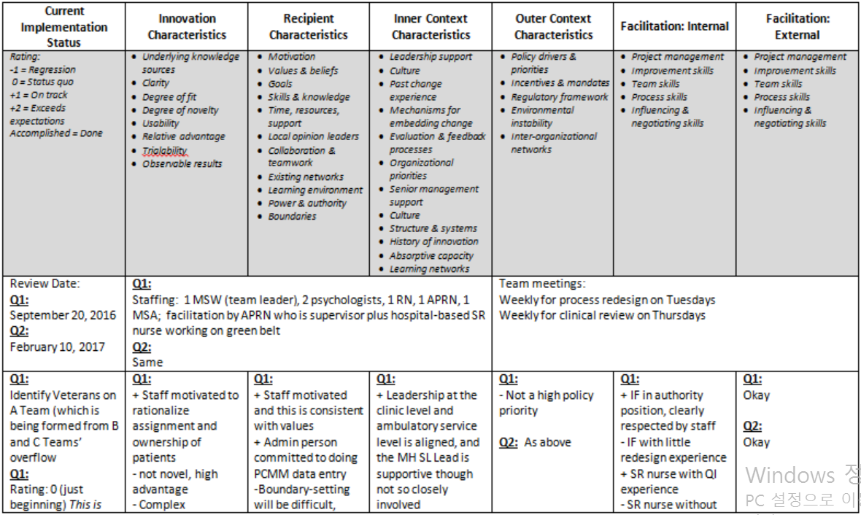
Observation Domain: Implementation Status
Implementation-focused
Progress-focused
DATA COLLECTION AID: i-PARIHS-based coordination document
FORMATIVE FEEDBACK MECHANISM: Weekly phone calls between EF and IF
Notes from implementation team meeting
Implementation progress and relevant considerations
Follow-up tasks review
Draft meeting agenda

Slide 16
Observation Domain: Resource Utilization
Implementation-focused
Progress-focused
OBSERVER | EF
SUBJECT | EF
MODE | EF logs facilitation activities and time spent on each activity
TIMING | Pre-implementation period, then two weeks each towards beginning, middle, and end of implementation period

Slide 17
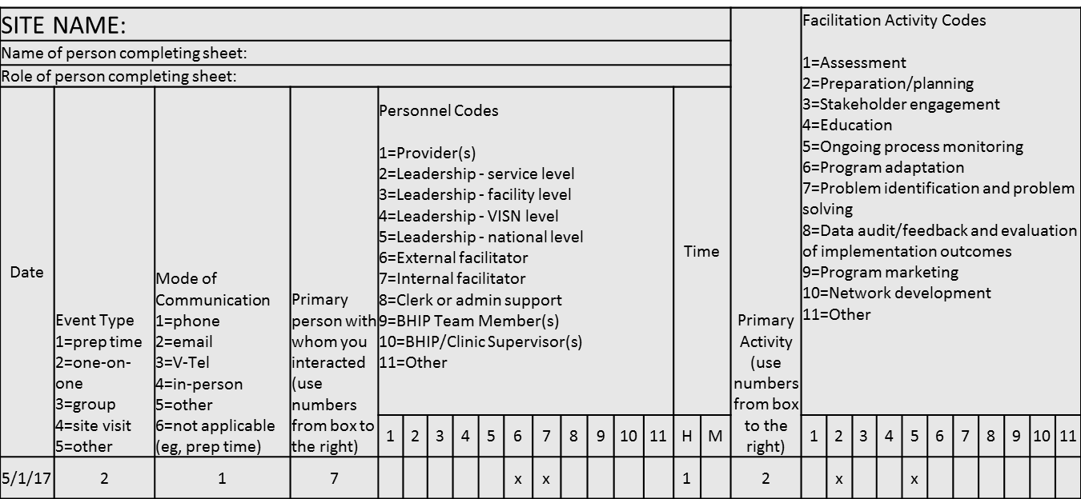
Observation Domain: Resource Utilization
Implementation-focused
Progress-focused
DATA COLLECTION AID: i-PARIHS-based time-motion tracker
FORMATIVE FEEDBACK MECHANISM: Quarterly comparison across EFs/sites

Slide 18
Observation for Mixed-Methods FE
DOMAIN | OBSERVER | SUBJECT | MODE | TIMING
Site Characteristics | EF | IF, team, stakeholders | EF holds phone/video/on-site conversations with IF, team, and stakeholders | Pre-implementation period of approximately six weeks
Implementation Status | EF, IF | EF, IF, team | EF joins IF-led team meeting over video | IF leads team meeting weekly; EF joins bi-weekly for first half of year-long implementation period, then with tapering frequency over second half
Resource Utilization | EF | EF | EF logs facilitation activities and time spent on each activity | Pre-implementation period, then two weeks each towards beginning, middle, and end of implementation period
Developmental
Interpretive
Implementation-focused
Progress-focused
Implementation-focused
Progress-focused

Slide 19
Limitations & Next Steps
Method’s data collection and feedback mechanisms are primarily EF-driven and EF-focused
Effectiveness of method in comparison to other formative evaluation approaches
Applicability of method to other facilitation within/outside behavioral health / VA

Slide 20
Translating Research into Practice
Practice implications for facilitation-driven implementation efforts | Generalizable practice implications
Direct observation of facilitation allows systematic/replicable collection and regular feedback of data on: Vocalized perceptions/interactions Nonverbal behavior/appearances Care setting/space Team/Clinical processes Utilization of facilitation resources Method can help steer facilitation activities toward implementation that fits local and changing contexts | Direct observation methodologies can enable structured collection and utilization of formative evaluation data for other implementation efforts that are non-facilitation-specific Data collection aids and feedback mechanisms can be adopted by implementation recipients for continued self-monitoring and communication with stakeholders to help ensure sustainability

Slide 21
Summary
Use of direct observation for formative evaluation of blended implementation facilitation work
Organized and coordinated gathering of behavioral, temporal, and contextual data through i-PARIHS-based data collection aids
Systematic feedback of data to facilitators through assessment report, EF-IF coordination, and cross-EF/site review

Slide 22
Thoroughly collect implementation data
Implementation
through
facilitation
Formative
evaluation
Mixed-methods
direct observation
Systematically feed the data back to shape implementation

Slide 23
Appendices

Slide 24
Objective
Implementation facilitation is being increasingly employed to enhance the use of evidence-based approaches in health care delivery
Limited established methods for:
Thoroughly collecting data on ongoing facilitation experiences
Systematically feeding them back to facilitators to help prospectively shape their facilitation activities
Aimed to develop/pilot a method for collection/feedback of data based on direct observation of facilitation activities

Slide 25
Formative Evaluation (FE)
Developmental
Implementation-focused
Progress-focused
Interpretive
Current practice
Intervention description
Potential barriers/facilitators
Project’s feasibility & perceived utility
Context of change
Exposure to / Experience of intervention
Monitoring of impact
Movement toward desired outcomes
Dose & intensity of implementation effort
Results explanation
Use/Triangulation of formative & summative data
Perceptions, reasons, recommendations
Stetler et al., 2006

Slide 26
i-PARIHS
Revision to the original PARIHS framework (Kitson, 2008), one of the first frameworks to highlight the importance of context and multidimensional complexity of implementing health care practices
Successful implementation (SI) is a function of the facilitation (Fac^{n}), innovation (I), recipients (R), and context (C):
SI = Fac^{n} (I + R + C)
Fac^{n} activates implementation through constantly assessing, aligning, and integrating the other constructs
Harvey & Kitson, 2016

Slide 27
Implementation Facilitation
From Ritchie et al. (2017)’s Implementation Facilitation Training Manual Version 2:
A multi-faceted process of enabling and supporting individuals, groups and organizations in their efforts to adopt and incorporate clinical innovations into routine practices
Can incorporate or include many other implementation strategies, e.g., audit and feedback, education and training, and stakeholder engagement

Slide 28
Blended Facilitation
External Facilitator (EF): Brings the content and process expertise to a site
Internal Facilitator (IF): Offers the experience and knowledge of the site’s organizational culture and existing procedures
Kirchner et al., 2014

Slide 29
Observation Parameters
DOMAIN | OBSERVER | SUBJECT | MODE | TIMING
Site Characteristics | EF | IF, team, stakeholders | EF holds phone/video/on-site conversations with IF, team, and stakeholders | Pre-implementation period of approximately six weeks
Implementation Status | EF, IF | EF, IF, team | EF joins IF-led team meeting over video | IF leads team meeting weekly; EF joins bi-weekly for first half of year-long implementation period, then with tapering frequency over second half
Resource Utilization | EF | EF | EF logs facilitation activities and time spent on each activity | Pre-implementation period, then two weeks each towards beginning, middle, and end of implementation period

