Slide 1
Implementation of Interventions for the Control of Typhoid Fever in Endemic Countries
Raluca Barac¹ Amruta Radhakrishnan¹ Daina Als¹ Michelle Gaffey¹ Zulfiqar Bhutta^{1,2} Melanie Barwick^{1,2,3} Centre for Global Child Health, The Hospital for Sick Children¹  Dalla Lana School of Public Health, University of Toronto²  Department of Psychiatry, Faculty of Medicine, University of Toronto
September 7-8 2017

Slide 2
The Problem
Typhoid fever remains a significant health burden in low and middle-income countries (LMICs) with little attention to the implementation of control interventions.
There are no data on the type of control interventions that have been implemented, nor do we know how effectively these interventions have been implemented.
Also unknown is whether rates of disease over time relate to the success or failure of control interventions or to the implementation approach, or both.
We need to understand how these interventions are implemented.
Notes:
Since the distinction between intervention effectiveness (typhoid control outcomes) and implementation effectiveness (whether interventions were well implemented) is important, the relative contributions of control interventions, such as investments in clean water, sanitation and hygiene (WASH) strategies, health and immunization strategies, food safety regulations or socioeconomic development remain unclear.
Although there is no empirical evidence on the implementation of typhoid control interventions specifically, there is some evidence on the facilitators and barriers to the implementation of other interventions in the context of LMICs, including exclusive breastfeeding, HPV vaccinations, antenatal care and maternal health and others [4-7]. Many implementation barriers appear to be common across countries. For instance, a secondary qualitative analysis of meeting reports and articles describing projects undertaken by Puchalski et al., [7] in five LMICs on three continents found a high degree of commonality for barriers across countries and clinical areas, with lack of financial, material, and human resources featuring as most prominent. In contrast, few facilitators were identified and these varied substantially across countries and interventions.
We have limited evidence about which implementation strategies are effective for promoting practice change in LMIC contexts. We also know little about effective implementation processes in LMIC contexts

Slide 3
Purpose of this Research
To address the knowledge gap related to the implementation of typhoid control interventions, we assessed:
The typhoid control interventions implemented between 1990 and 2015 in eight countries: Bangladesh, Chile, India, Nigeria, Pakistan, Thailand, South Africa, and Vietnam
The contextual factors associated with the implementation of control interventions
This study adds to a body of work, by our team and others, to explore CFIR factors related to implementation success

Slide 4
Implementation Framework
The study was guided by the Consolidated Framework for Implementation Research, or CFIR (Damschroder LJ, Aron DC, Keith RE, Kirsh SR, Alexander JA, Lowery JC. Implement Sci. 2009 7;4:50.).
The CFIR focuses on the contextual factors associated with implementation success and includes 37 measurable factors organized under five domains: Intervention Characteristics, Process, Inner Setting, Outer Setting, and Characteristics of the Practitioner.
Notes:
The contribution of the CFIR is that it allows for the comprehensive examination of a variety of contextual factors that are empirically associated with successful implementation across a variety of disciplines (e.g., global health, education, mental health, etc.) and that may not have been taken into account in studies using controlled designs that would have ‘blocked’ or ignored them. CFIR also enables examination of specific challenges, barriers, and facilitators identified during implementation and evaluation of programs that have the potential to modify the effect of an intervention. For instance, a study of exclusive breastfeeding implementation in Ethiopia and Mali revealed several contextual factors that were strongly related to improved exclusive breastfeeding rates in both countries [4] including adaptation, relative advantage, complexity, needs of the target population, networking, external policies and incentives, tension for change, change agents, and implementers’ knowledge and attitudes about the intervention, and establishing strong champions for the intervention.

Slide 5
Design
mixed methods
combined qualitative data from key informant interviews of purposefully selected public health experts
with quantitative data from the CFIR questionnaire
collected from 8 countries
Notes:
This implementation study was conducted as a complement to a larger study exploring country-specific data sets for rates of disease burden over time [11-18]. Scoping of typhoid-relevant interventions implemented in these eight countries, as well as contextual implementation factors perceived to be associated with decreasing typhoid rates allows for identification of commonalities and differences for these factors across contexts and has the potential to inform implementation research and practice as well as policy and priority setting about interventions to tackle the global burden of typhoid. Together with the results of our larger quantitative study [2, 11-18] these findings could facilitate the development of an evidence-based implementation approach for the control of typhoid in LMICs.

Slide 6
Methods
Participants
34 public health experts (19 men, 15 women; M age = 57.3 years, SD = 10.5 years)
from the 8 aforementioned countries
identified by the study leads in each country, based on their expertise in public health (M work experience = 29.0 years, SD = 10.3 years).

Slide 7
Data Collection and Analyses
Semi-structured interviews
An interview protocol was followed in each country to explore a pre-determined set of typhoid control interventions:
public health campaigns and vaccinations for typhoid;
diarrheal disease control;
food safety; food handlers;
agricultural practices;
treatment of sewage;
antibiotic medication.
Data were analyzed using a deductive qualitative content analysis against the CFIR framework.
Notes:
Qualitative data consisted of semi-structured interviews with key informants. With the exception of South Africa, where data were collected via phone interviews, interviews were conducted in person, audio-taped, and transcribed verbatim. With the exception of Chile, all interviews were conducted in English. In Chile, interviews were conducted by local researchers in Spanish, audio-recorded and subsequently translated to English locally. The same interview protocol (see S1 Appendix A) was followed in each country to explore a pre-determined set of typhoid-relevant interventions and factors (i.e., public health campaigns and vaccinations for typhoid; diarrheal disease control; food safety; food handlers; agricultural practices; treatment of sewage; antibiotic medication; and migration). At the same time, informants were also invited to discuss additional interventions or contextual factors they believed to be relevant for their country. The interview protocol was developed based on our conceptual framework [2] and literature review.

Slide 8
Data Collection and Analyses
CFIR questionnaire: A questionnaire documented the implementation of typhoid control interventions related to: intervention characteristics, inner and outer settings, process, and staff characteristics.
Items were rated on a 5-point Likert scale and summary descriptive statistics were calculated for all domains and factors to show their relative importance.
Chile did not participate in CFIR interviews.
Notes:
The CFIR questionnaire, developed by the authors (MB, RB) for an earlier study [22], was used to document specific aspects of the implementation of typhoid-relevant interventions related to: intervention characteristics (8 items), inner (12 items) and outer settings (4 items), process (8 items), and staff characteristics (5 items), for a total of 37 questions. Items were rated on a 5-point Likert scale (1 ‘very unimportant’; 5 ‘very important’).

Slide 9
What We Learned
Despite relatively few typhoid-specific interventions reportedly implemented in these eight countries, all countries implemented interventions for diarrheal disease control and regulations for food safety and food handlers.
Most countries implemented agricultural and sewage treatment practices and very few addressed the control of antibiotic medication.
Several contextual factors were perceived to have influenced the implementation of typhoid interventions, either as enablers (economic development; the use of multiple implementation strategies; other epidemics or outbreaks; changes in government administration; the pressure of hosting an international event) or barriers (limited resources, planning; habitual behaviors and cultural practices; migration).
CFIR factors rated as important in the implementation of typhoid interventions were remarkably consistent across countries.

Slide 10
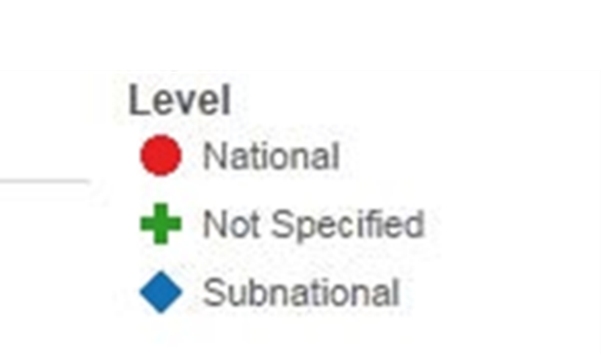
Qualitative Results: Interventions Implemented in Eight Countries in Africa, Asia and Latin America and their Perceived Effectiveness
Notes:
Figure 1 summarizes the seven types of typhoid-relevant interventions implemented in each of the eight countries between 1990 and 2015, along with an indication of the scope of the target population (i.e., national or subnational). Overall, relatively few typhoid-specific interventions were reportedly implemented in these eight countries, however all countries implemented interventions for diarrheal disease control and regulations for food safety and food handlers. While, most countries implemented agricultural and sewage treatment practices, very few addressed the control of antibiotic medication. No additional control interventions were mentioned by the participants in any of the eight countries, over and above those included in the interview.
Typhoid-specific interventions. Typhoid-specific interventions typically occurred in response to local typhoid outbreaks, and included vaccination campaigns; public education regarding the causes, treatment and prevention of typhoid fever; and physician education to improve diagnosis and treatment. In Vietnam, for instance, typhoid fever outbreaks in the Mekong River Delta in the early 1990s triggered vaccination programs in the area, as well as public education about proper hand washing techniques and boiling water prior to consumption. Typhoid-relevant interventions in Pakistan were implemented in response to emergency situations, such as the earthquake in 2005 and floods in 2010, and focused on vaccinations for children under 5 years of age living in the affected areas, and public educating about clean water and sanitation. Typhoid control in South Africa was similar, such that local typhoid outbreaks stimulated improvements in water systems, vaccination campaigns, and fever screening for migrants at the borders. Not all countries reportedly implemented interventions specifically targeting typhoid fever (i.e., Nigeria and Bangladesh reported no typhoid-specific interventions between 1990 and 2015).

Slide 11
Qualitative Results: Interventions Implemented in Eight Countries in Africa, Asia and Latin America and Their Perceived Effectiveness

Slide 12
Qualitative Results: Interventions Implemented in Eight Countries in Africa, Asia and Latin America and their Perceived Effectiveness

Slide 13
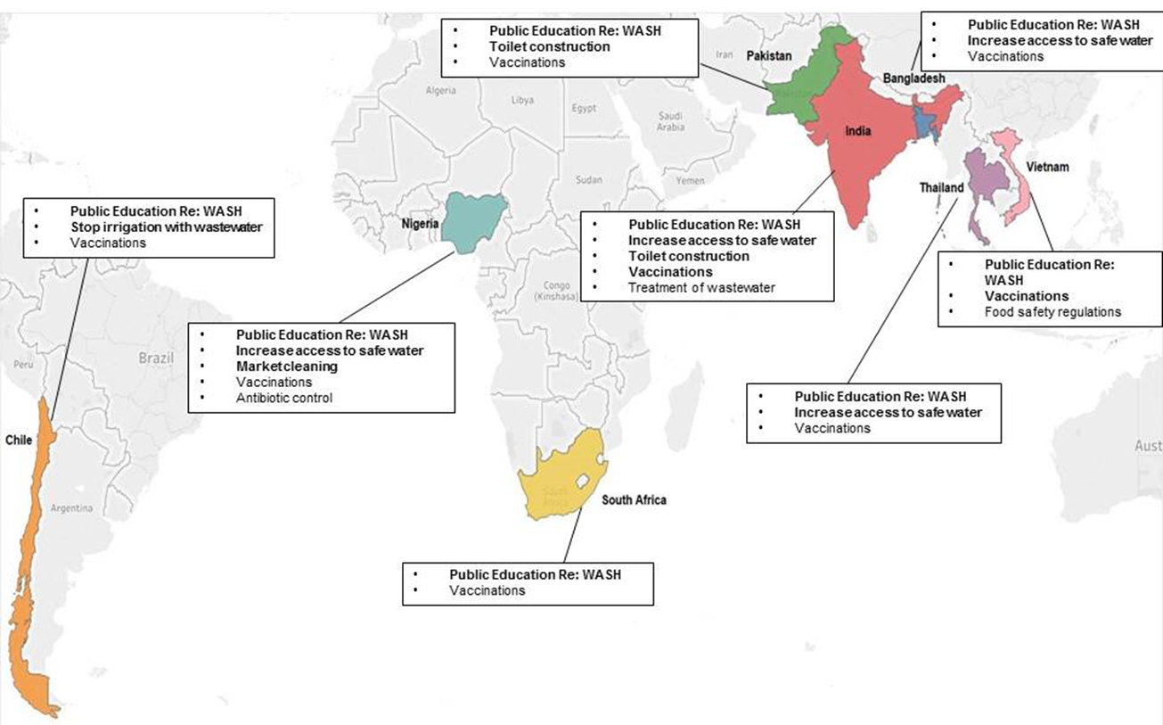
Map showing the most (in bold) and least effective interventions for typhoid control according to key interviewees in eight endemic countries.
Public education specifically refers to community education campaigns regarding water, sanitation and hygiene (WASH).

Slide 14
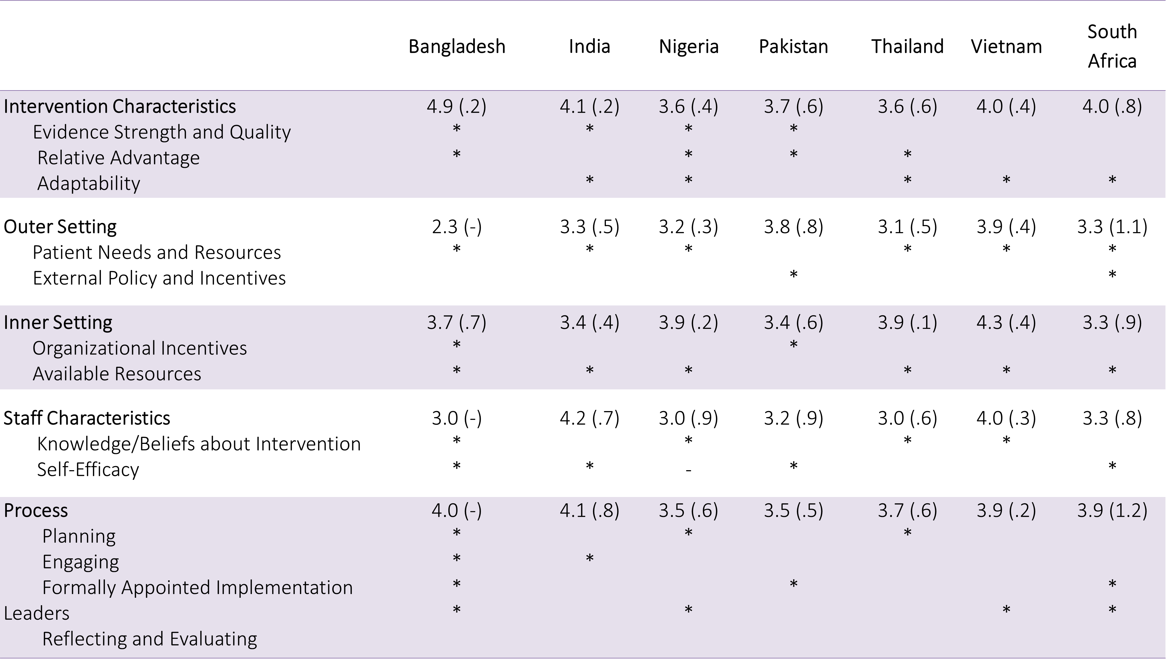
Quantitative Results: Contextual Factors Affecting the Implementation of Typhoid Control Interventions
Notes:
Table 2 summarizes the means and standard deviations for CFIR domains, and within each domain, for the construct with the highest ratings in each of the eight countries. The average ratings for the 5 CFIR domains were centered around and above the middle point of the scale. The same constructs were consistently rated as highly associated with implementation success across the eight countries: Intervention Characteristics 1) evidence strength and quality, 2) relative advantage, and 3) adaptability; Outer Setting 1) patient needs and resources and 2) external policy and incentives; Inner Setting 1) organizational incentives and rewards and 2) available resources; Staff Characteristics 1) knowledge and beliefs about the intervention and 2) self-efficacy; Process 1) planning, 2) engaging, 3) formally appointed implementation leaders, and 4) reflecting and evaluating.
In addition, qualitative analyses highlighted several contextual factors perceived to have influenced the implementation of typhoid-relevant interventions as enablers (economic development; the use of multiple implementation strategies; other epidemics or outbreaks; changes in government administration; the pressure of hosting an international event) or barriers (limited resources and planning; habitual behaviors and cultural practices; and migration) (see Table 3). Most barriers and some of the enabling factors (i.e., economic development; the use of multiple implementation strategies) were commonly noted across countries, although some enabling factors were unique to a specific country (e.g., changes in government administration in Thailand; the pressure of hosting an international event in Nigeria; other epidemics or outbreaks in Nigeria and Chile).

Slide 15
Conclusions
Study findings provide a snapshot of typhoid control interventions implemented in 8 countries over 25 years, and the factors associated with implementation success from the perspective of a small sample of key informants working in public health.
Results are consistent with past research on the CFIR contextual factors associated with implementation success in different sectors (health, global health, mental health), and settings (low and high income countries).
Knowing which factors are more ‘important’ relative to effective implementation has implications for advancing implementation knowledge and practice in global health, such that factors emerging as highly associated with success can be taken into account in implementation planning, monitoring and evaluation.
Our findings inform future systematic investigations of the implementation of typhoid control interventions and LMIC health evidence implementation more broadly, as well as contribute to a better understanding of how such implementation efforts impact typhoid rates.

Slide 16
Acknowledgements
Funding for this project was made to Dr. Zulfiqar A Bhutta from the Bill & Melinda Gates Foundation; Tackling Typhoid – What Do Global & Country Trends Teach Us?
Dr. Barwick was senior responsible author.
Dr. Barac covered data collection and analysis, along with Daina Als and Amruta Radhakrishnan.
Ms. Gaffey was senior research manager for Dr. Bhutta.
Manuscript has been submitted to PLOS-NOS

